Slide 1
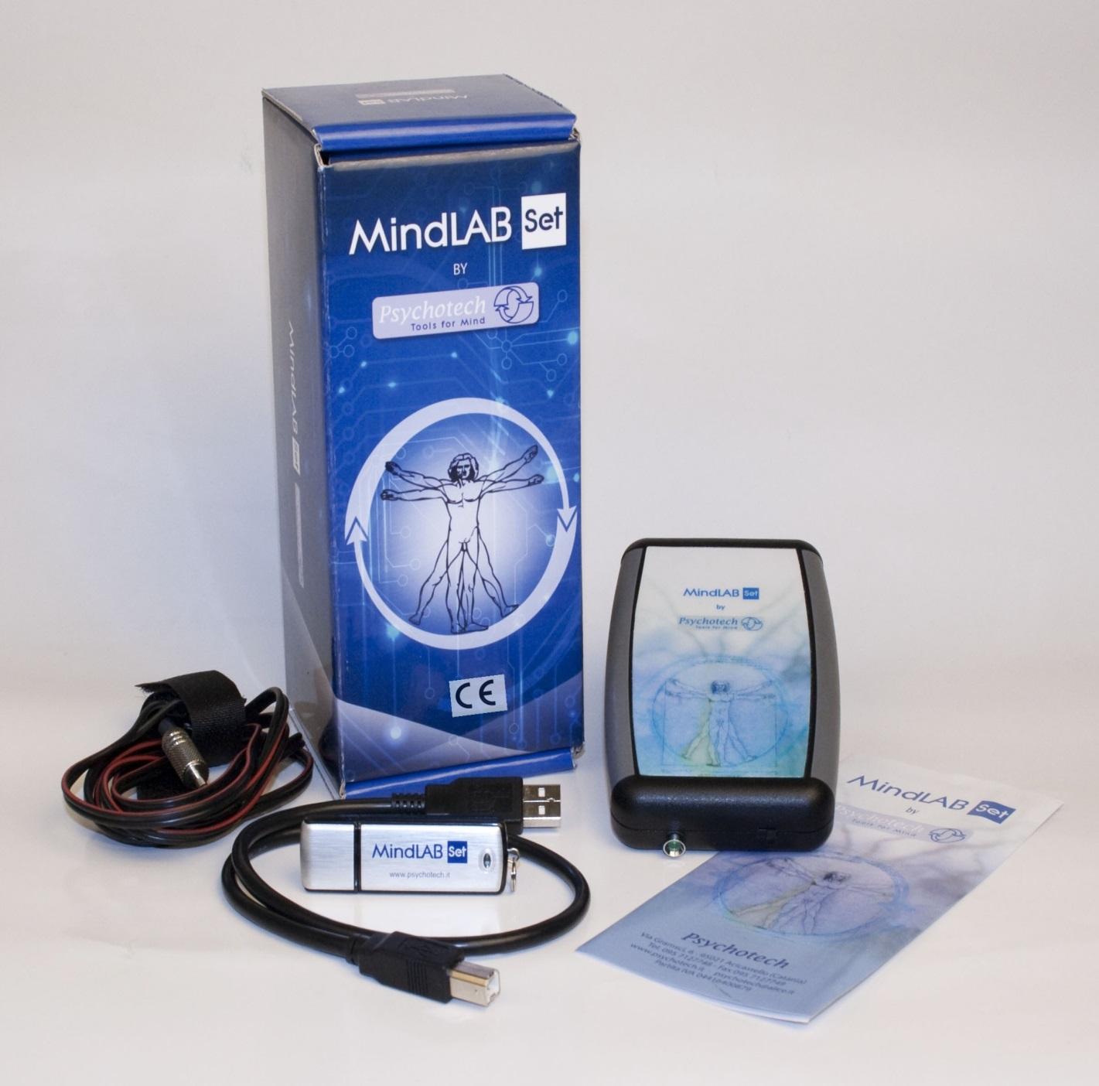
Tullio Scrimali
Professor of Clinical Psychology, University of Catania, Catania, Italy
Founder and Director of ALETEIA International, European School of Cognitive Therapy, Enna
web site: www.tullioscrimali.it - www.aleteiainternational.it
e-mail: tscrima@tin.it
NEUROSCIENCE-BASED
COGNITIVE THERAPY
State of Art and Future Perspectives
ALETEIA Publisher
All right are reserved to the Author, Prof. Tullio Scrimali
Please, quote, in your references, this presentation as:
Scrimali, T. (2016). Neuroscience-Based Cognitive Therapy: An overview
ALETEIA Publisher; on the web at: www.aleteiapublisher.eu

Slide 2
Neuroscience-Based
Cognitive Therapy
Neuroscience constitutes one of the most important advance in contemporary Science.
The recent studies and research in this field have dramatically affected our understanding of what occurs in human mind and in which way we can work for changing the states and processes of human brain.

Slide 3
During last 40 years I have done a hard work at the interface between Neuroscience and Cognitive Therapy, and, therefore, between the laboratory and the clinical setting.
Thanks to this work, I have been able to establish a new discipline, called…

Slide 4
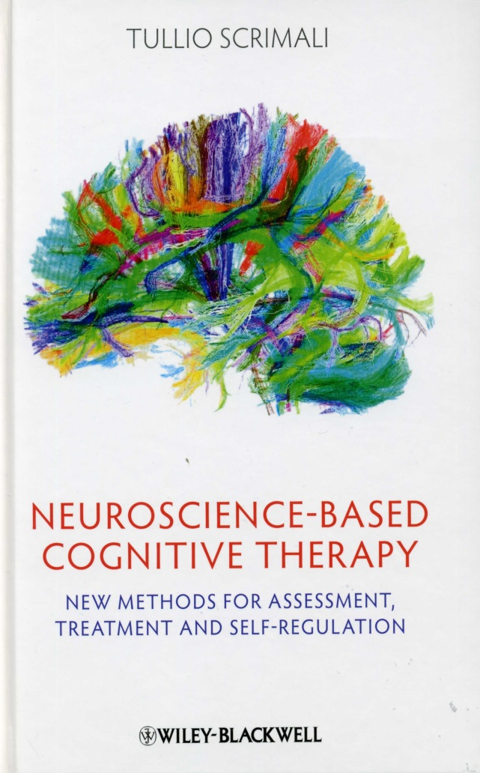
Neuroscience-Based Cognitive Therapy

Slide 5
It is a new approach to Cognitive Therapy which attracted some interest from all around the World.
5

Slide 6


Slide 7

7

Slide 8
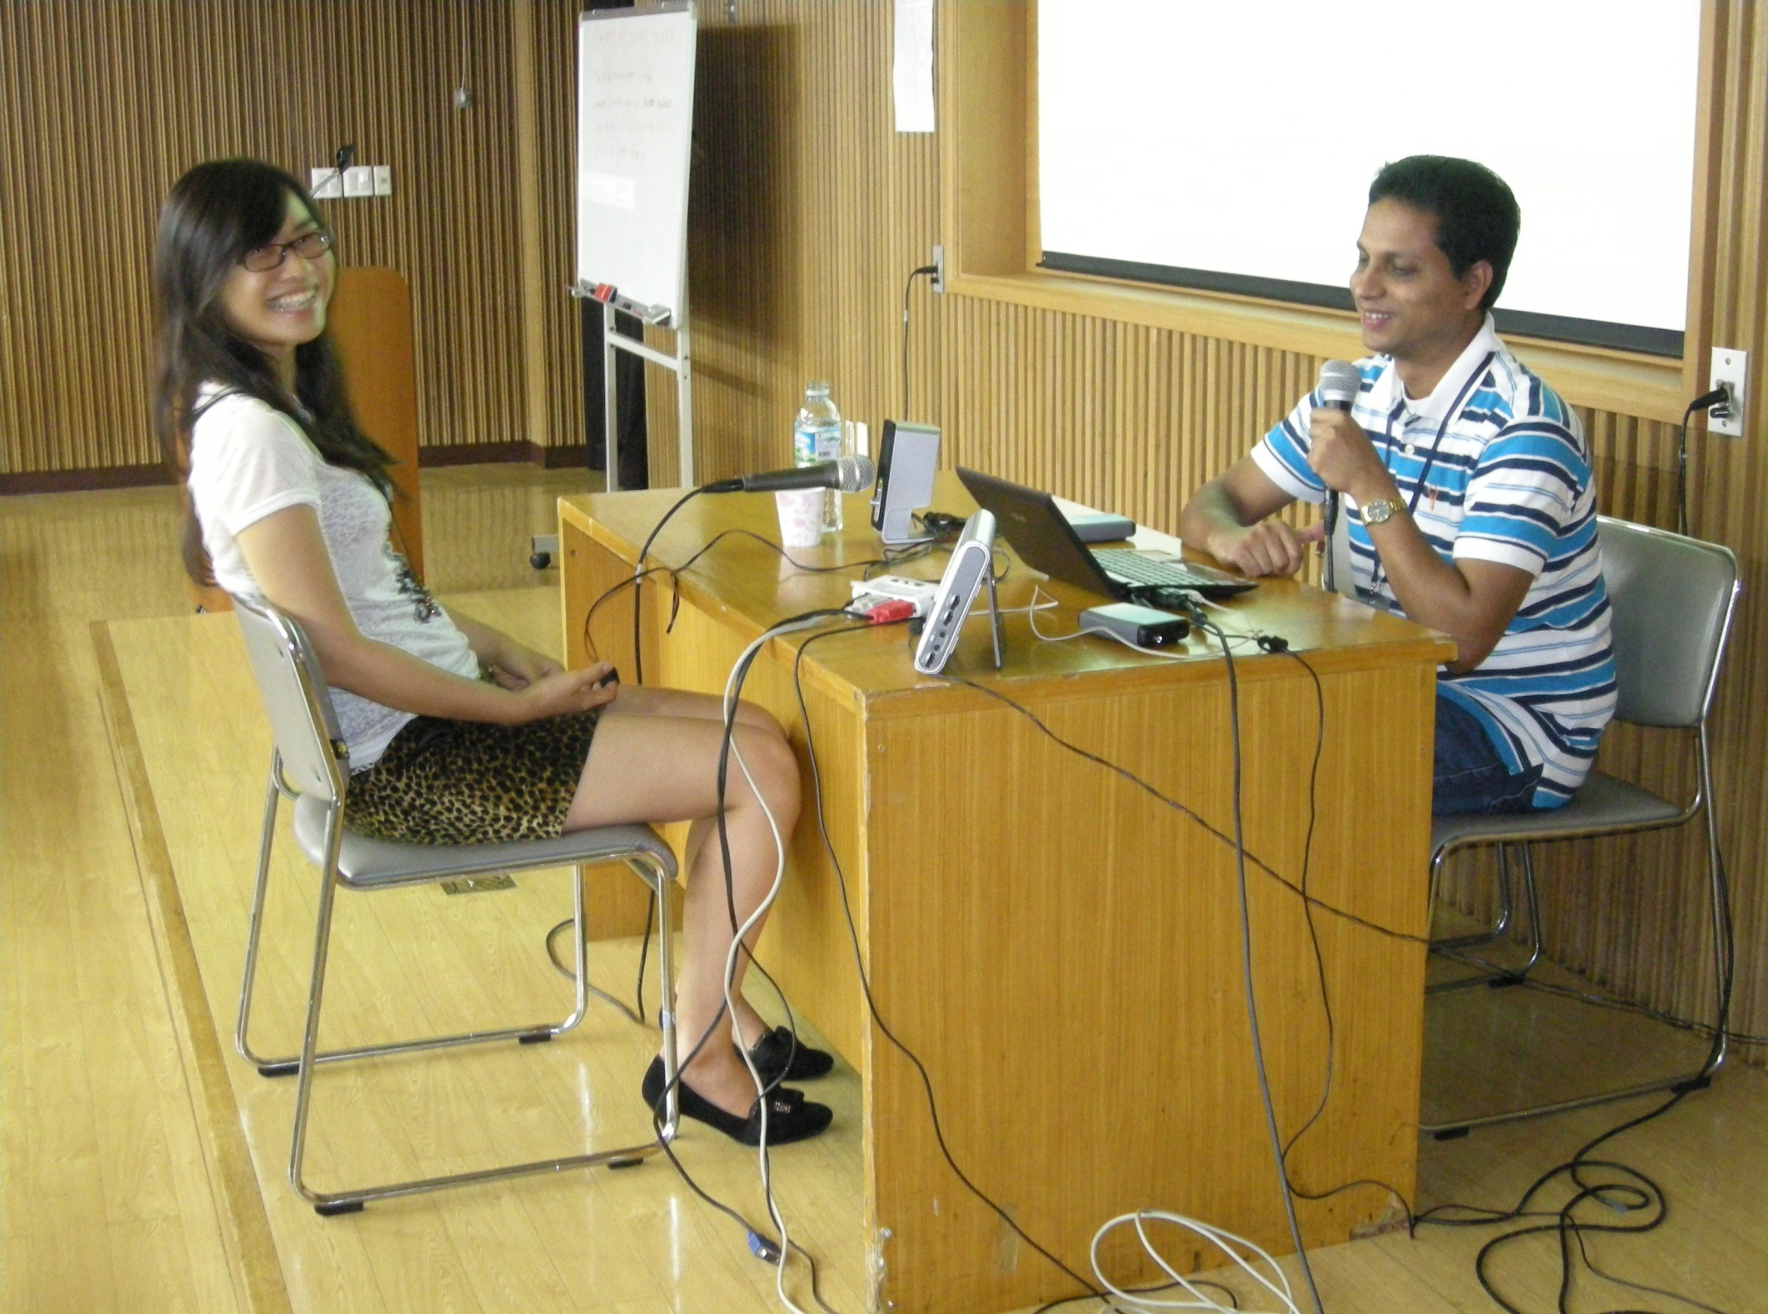
  8

Slide 9

  9

Slide 10
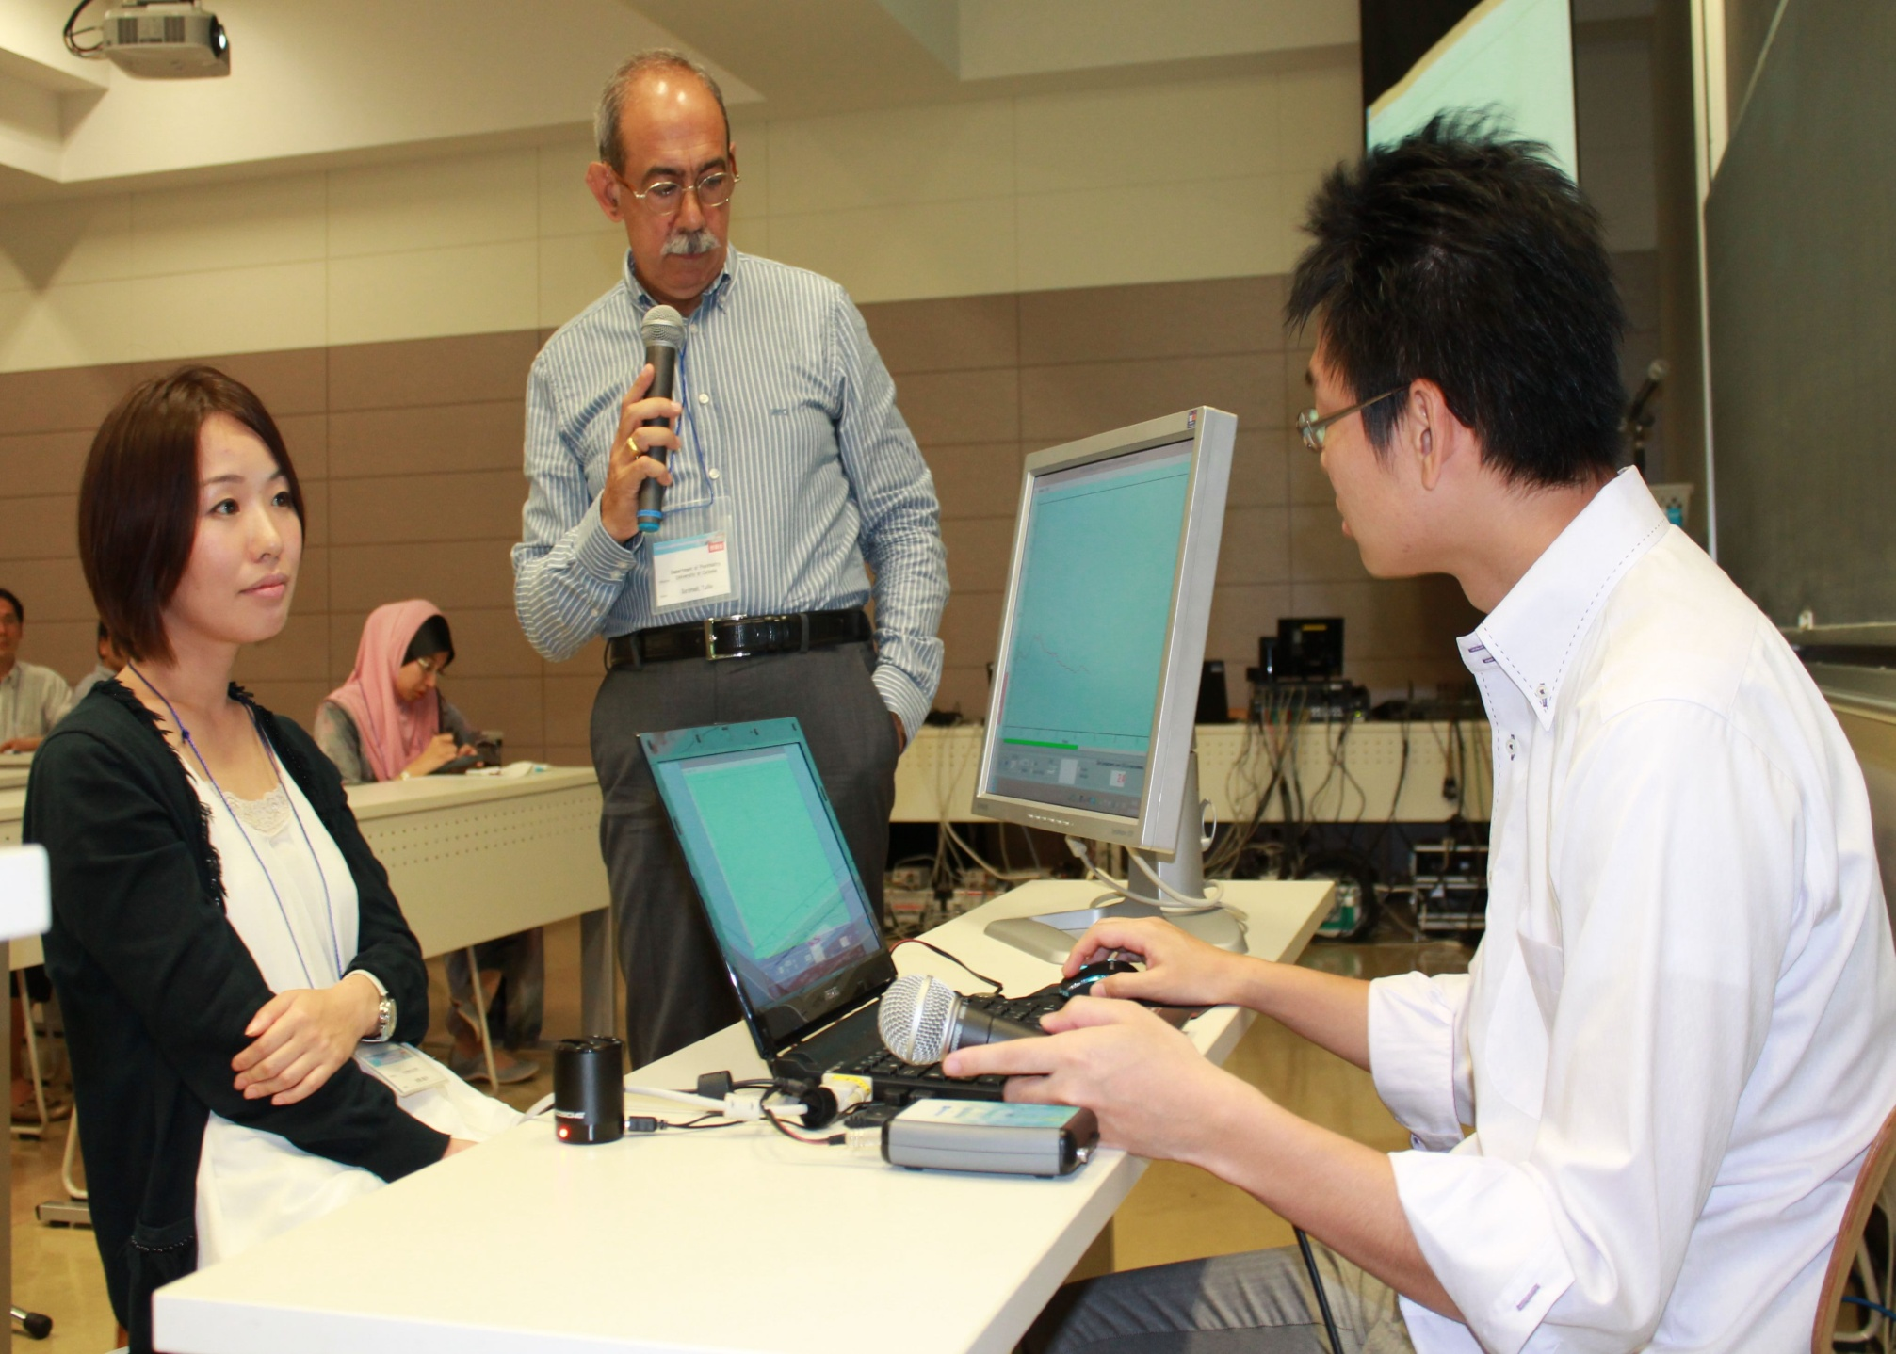

Slide 11
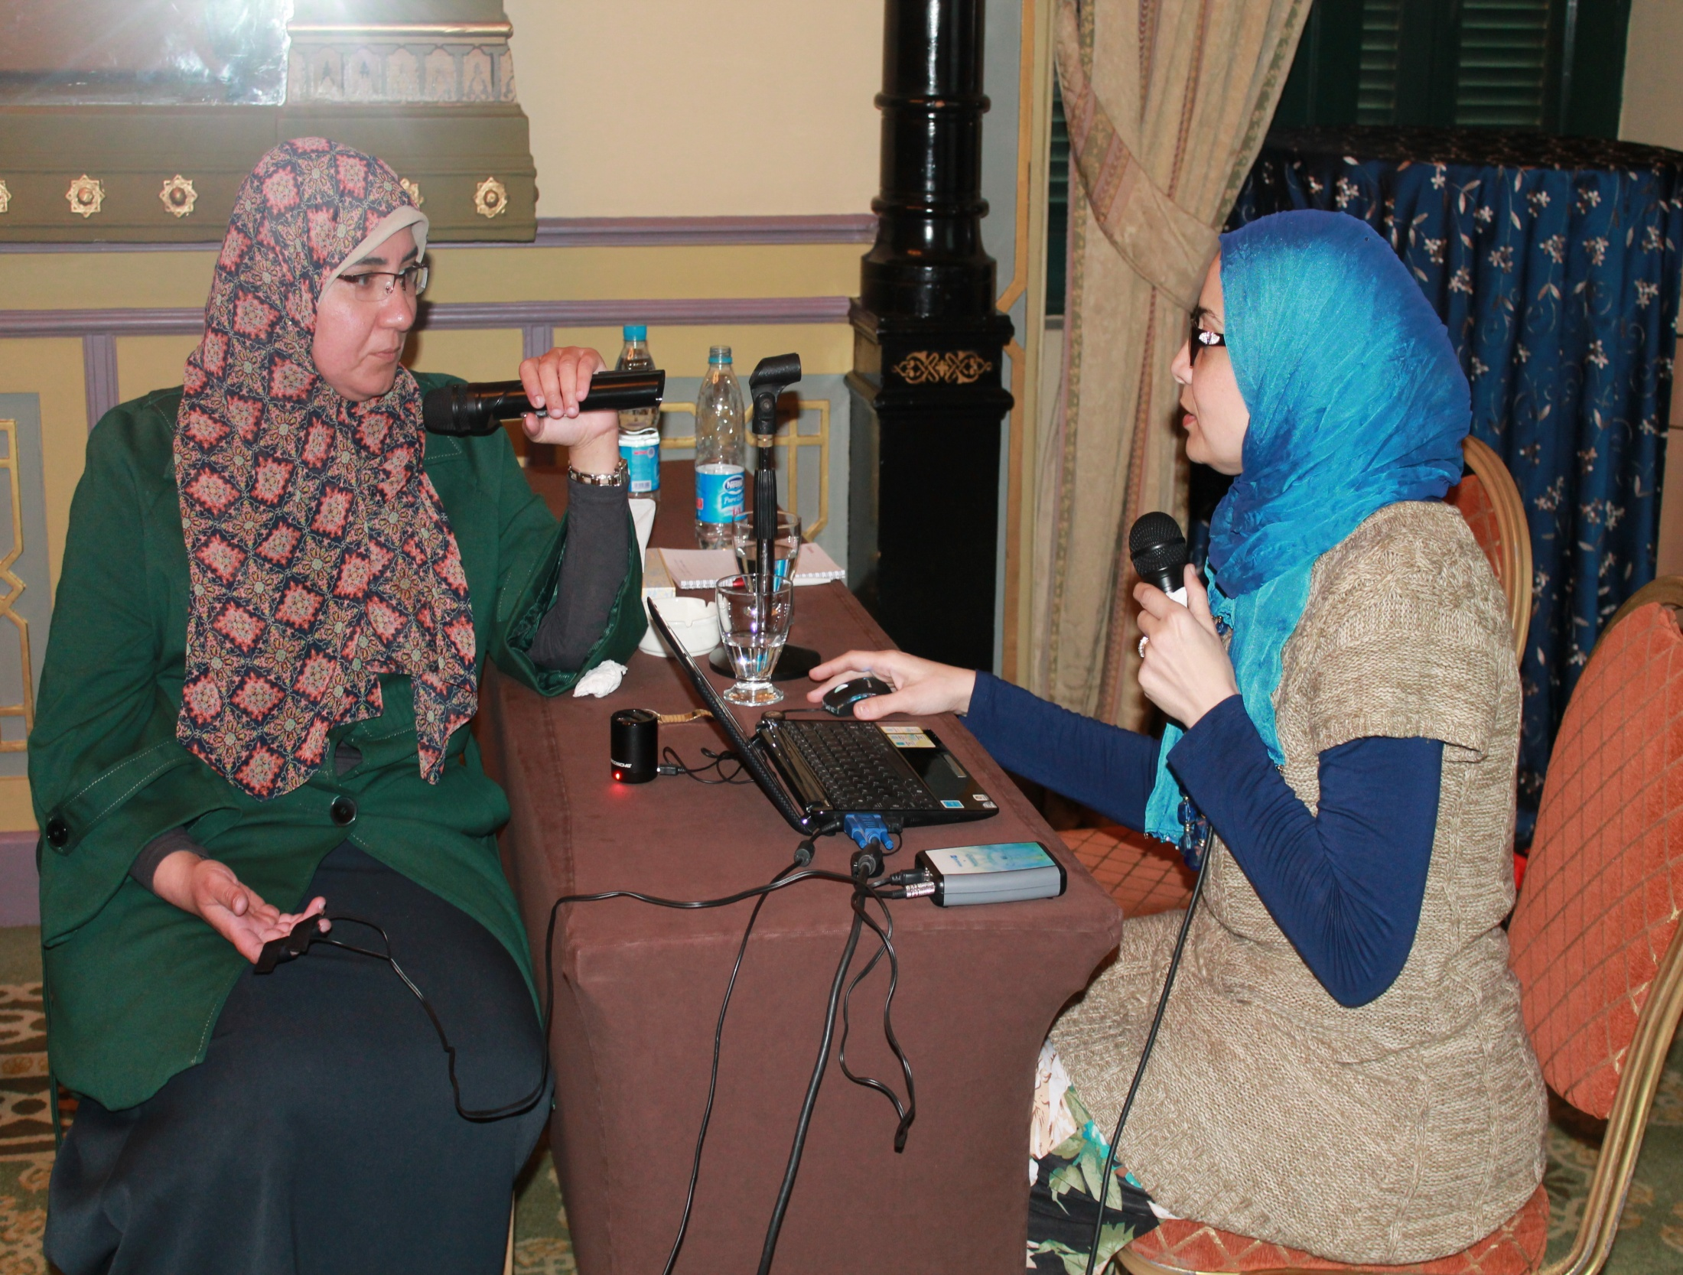

Slide 12
New Trends in Neuroscience
The most important new trends in Neuroscience, that are relevant for Cognitive Therapy, according to my point of view, are…

Slide 13
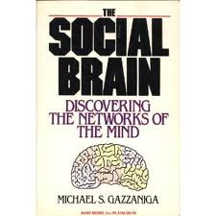
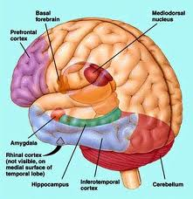
Neuroscience of social processes
  13

Slide 14
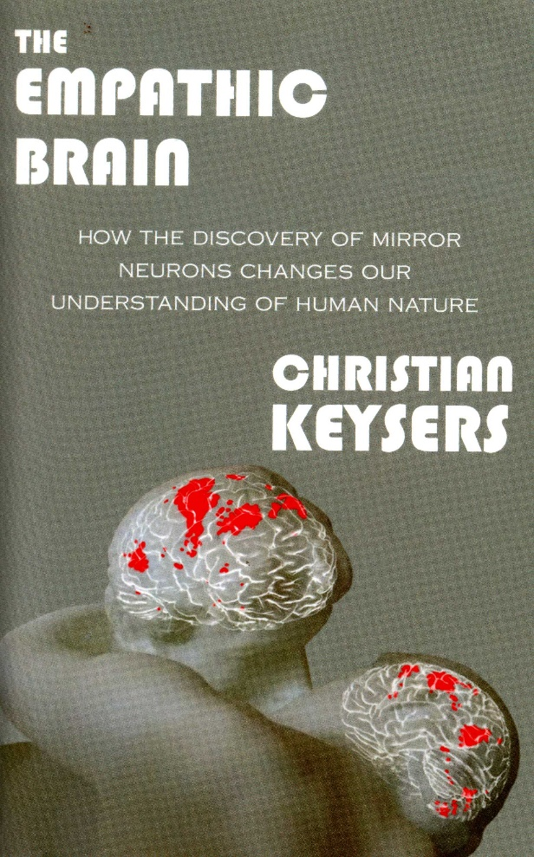

Slide 15
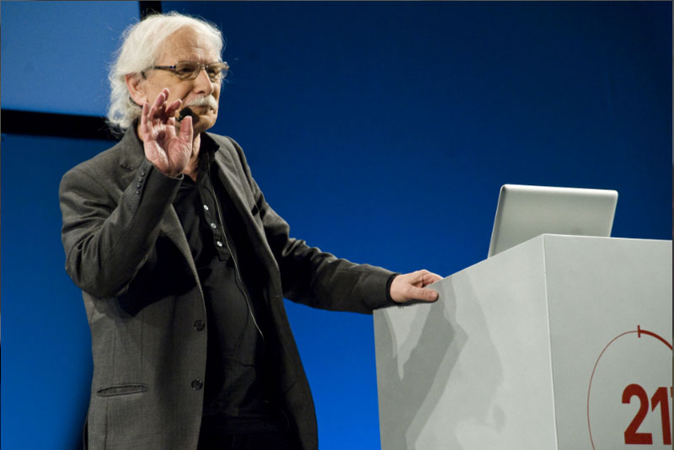
Mirror Neurons an Italian discovery!

Slide 16

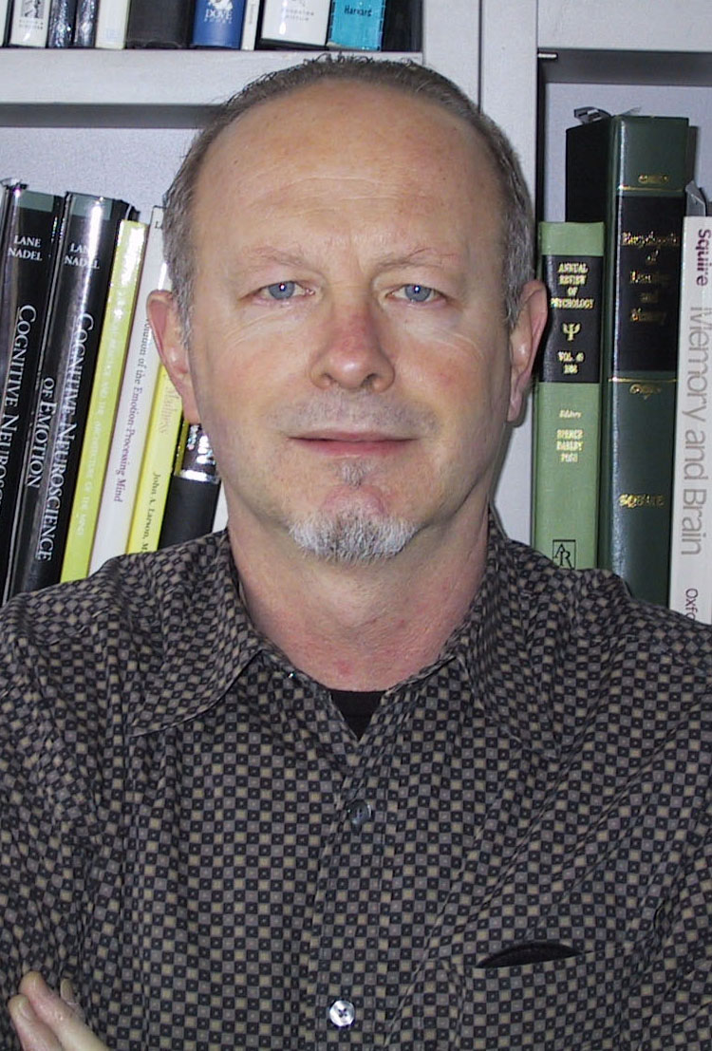
Emotion too is now on the focus of Neuroscience, thanks to the seminal work of Joseph LeDoux.

Slide 17
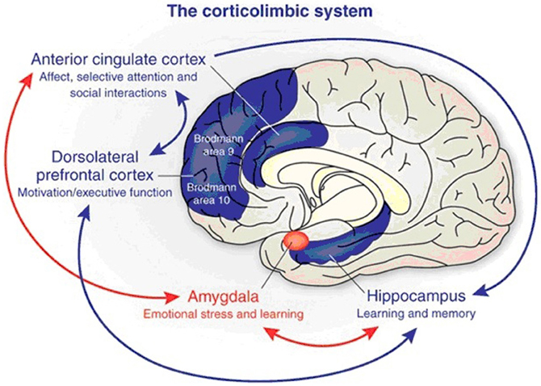

Slide 18
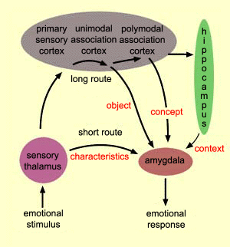

Slide 19
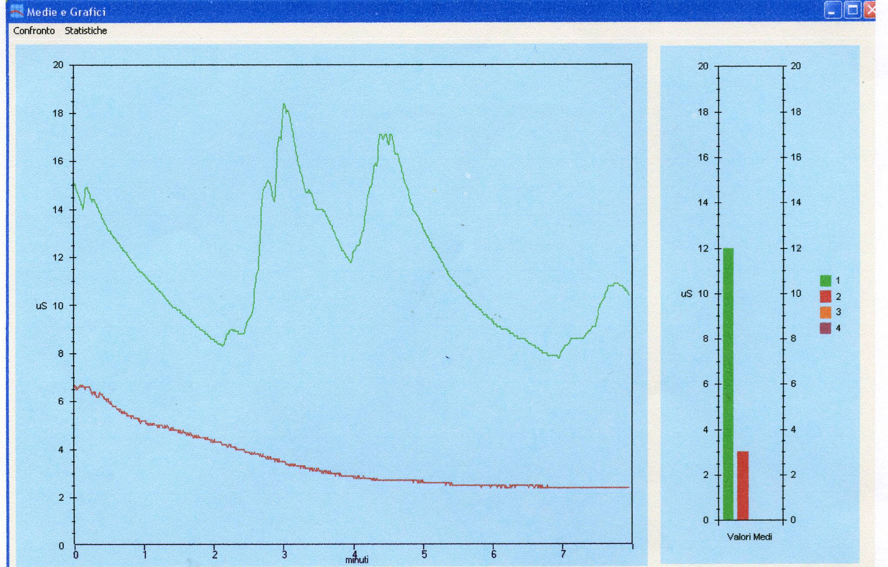
Exposure to some phobic stimuli during psychotherapy in my Lab
  19

Slide 20
The picture represents two registrations of electrodermal activity, carried out by means of a MindLAB Set by Psychotech (www.psychotech.it).
The patient was a phobic one. She was scared by “dirty” objects.
In the first plot (green) you can see as the touch of a note created a large arousal response (short limbic route).
One the contrary, after a training of biofeedback, (red plot) and a CBT, the patient was able to touch the note without showing any emotional response (long route to prefrontal cortex!).
The amygdala was tamed by the pre-frontal cortex which was re-programmed by psychotherapy.

Slide 21
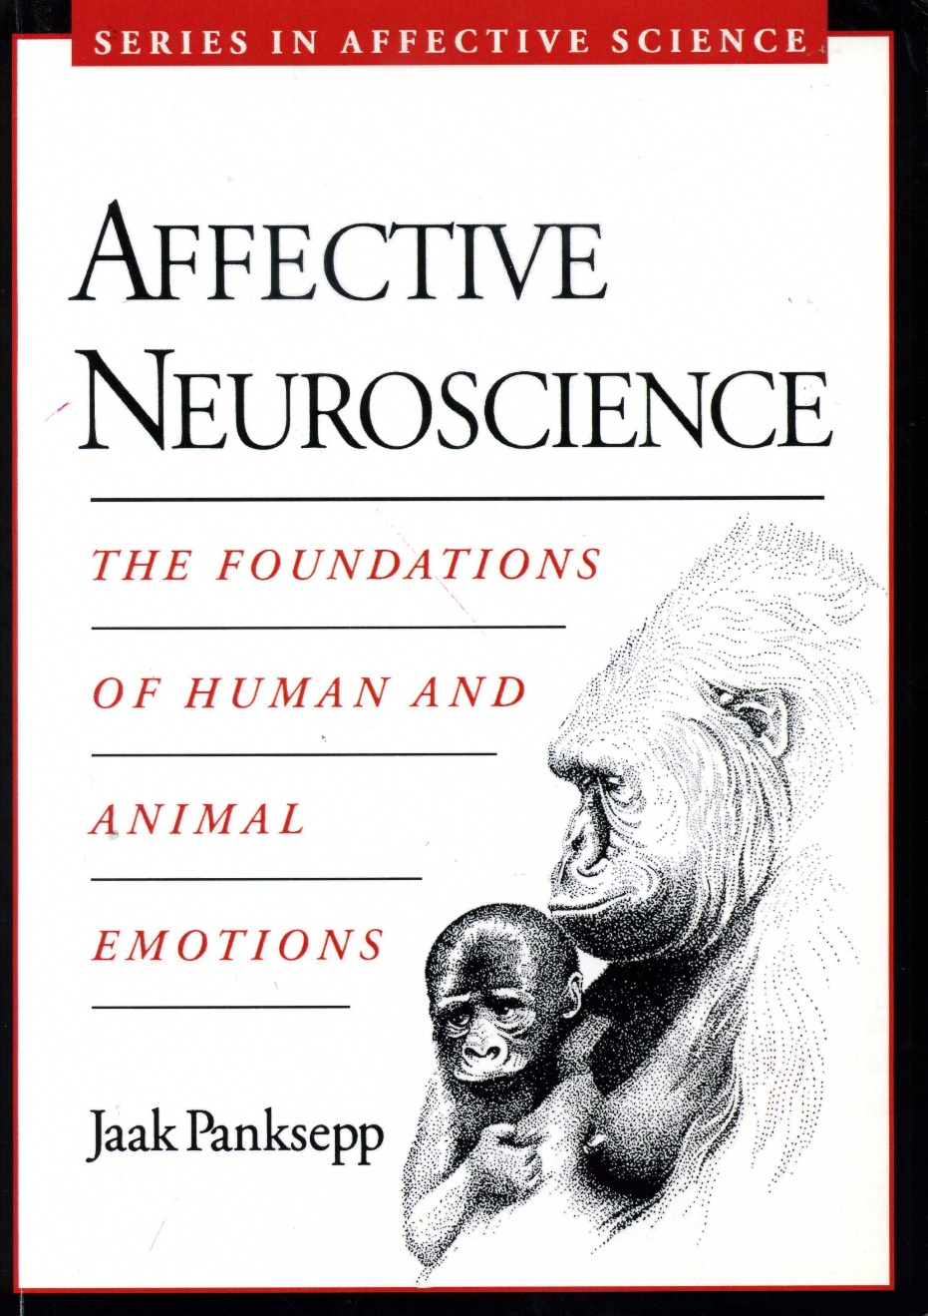

Slide 22
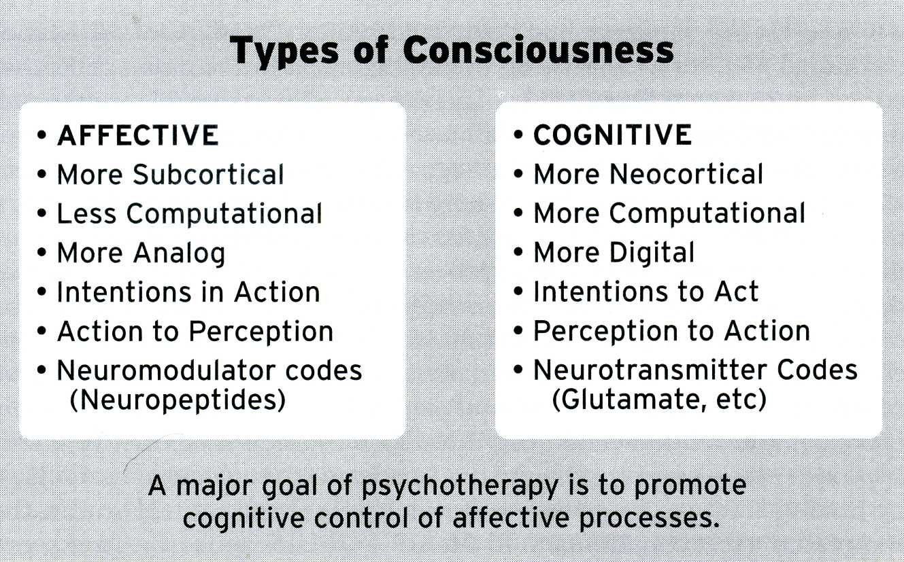

Slide 23
Tacit knowledge
According to the progress of affective neuroscience, the concept of «unconscious», revisited as «tacit knowledge» (emotion), should be considered aside to explicit knowledge (cognition).

Slide 24
I elaborated a new model of schizophrenia and its therapy in which I fully applied my research on neuroscience.
I renamed schizophrenia “entropy of mind” and the original CBT protocol I use “negative entropy”.

Slide 25


Slide 26
Material and Methods of Neuroscience Based Cognitive Therapy
26

Slide 27
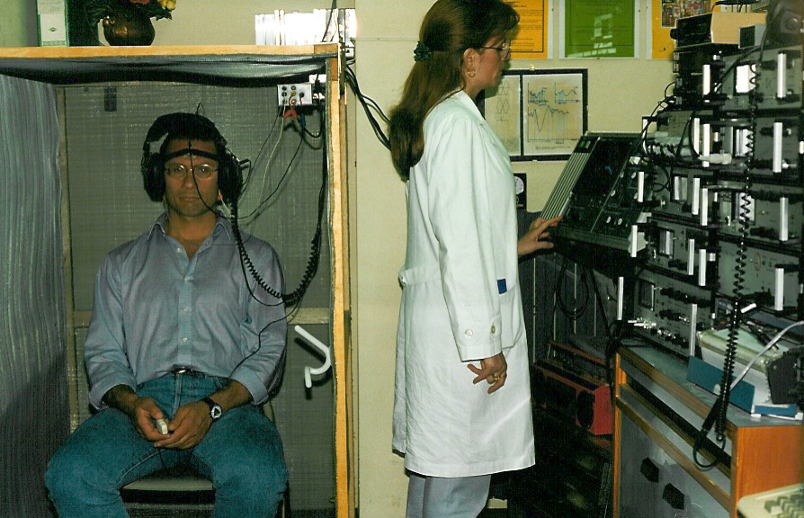
27

Slide 28
That represented in the previous slide was was my Lab about 20 years ago!

Slide 29

29

Slide 30
Ten years lather the same Lab was contained in a small luggage I brought all around the World (see the small case I am carrying!)
Nowadays the MindLAB Set can stay in you pocket!

Slide 31
  31

Slide 32
MindLAB SET
Is a system, I developed, composed by a hardware and a software, which can be used together with a computer.
It allows any clinician to apply, in the clinical field, QEDA and Psychofeedback.
In fact, MindLAB Set is cheap, easy to learn, easy to apply and scientifically validated.

Slide 33
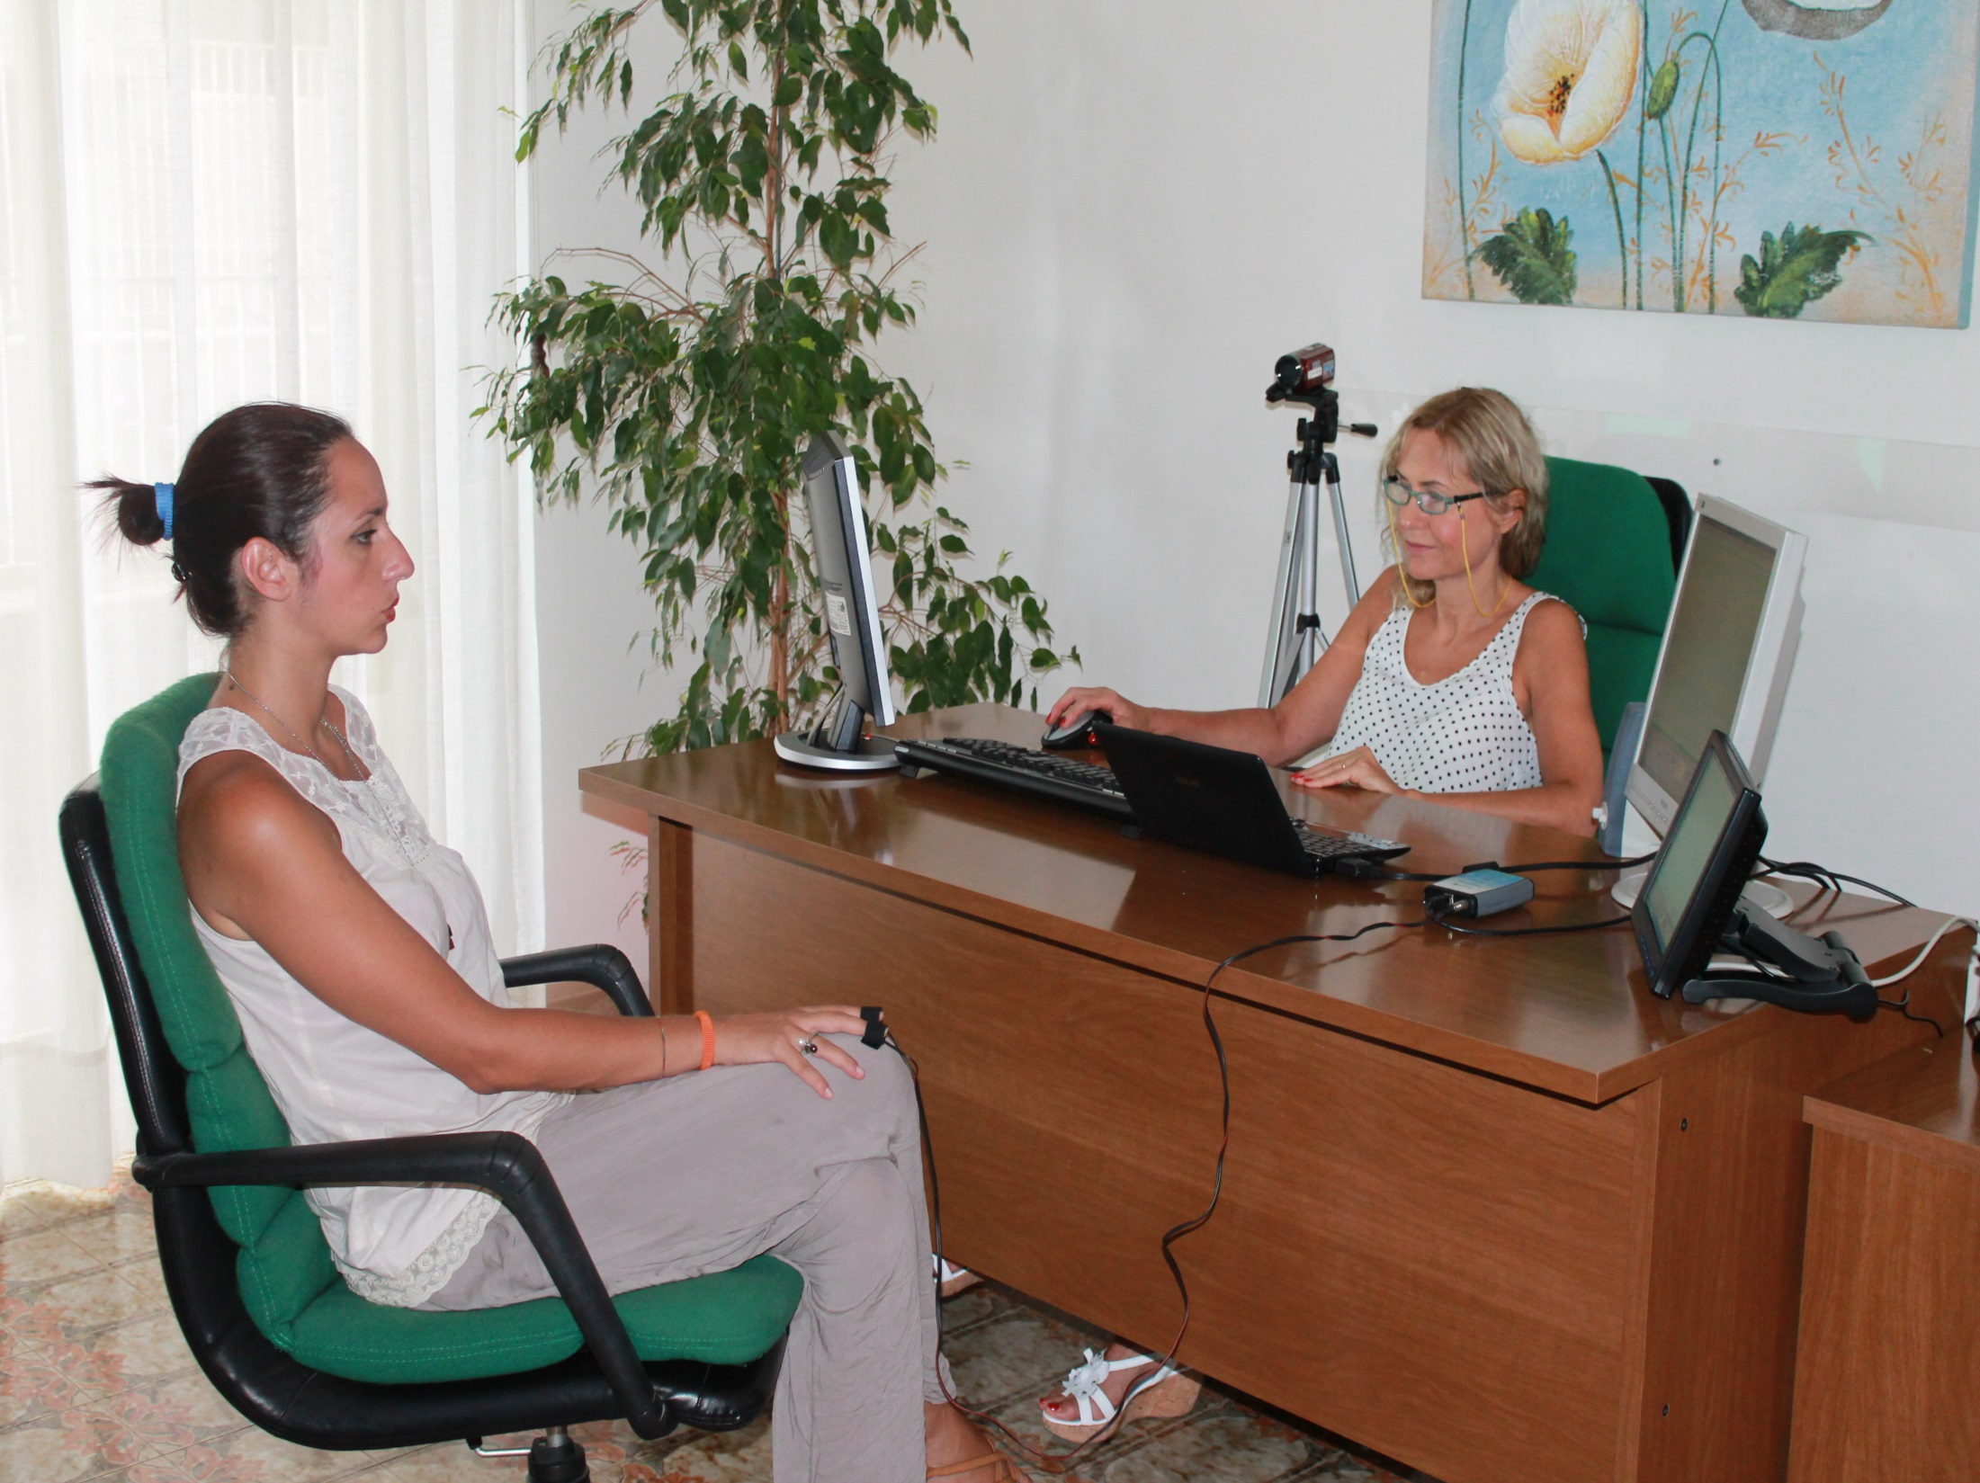
Neuroscience-based setting when applied in CBT

Slide 34
The two most important methods of Neuroscience-Based Cognitive Therapy
The two most relevant methods that I applied in NBCT are:
QEEG and Neurofeedback
EDA and Biofeedback

Slide 35
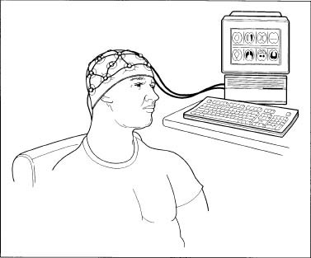
Quantitative Electroencephalography (QEEG)

Slide 36
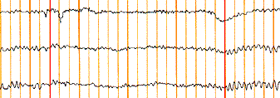
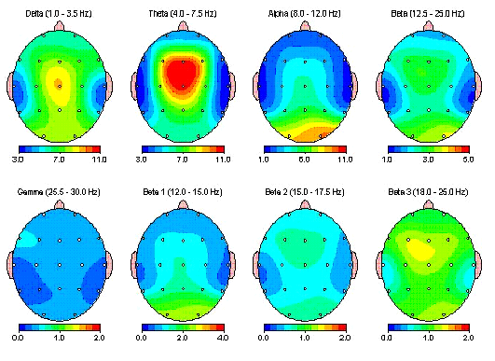
Thanks to an automatic Fast Fourier Analysis, an usual EEG, as follows:
is transformed in a QEEG
able to give immediate and clear information about the full spectrum and the precise location of any frequency.

Slide 37
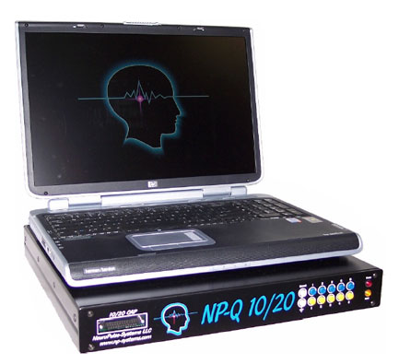
  37
The Mindset NP-Q 10/20.

Slide 38
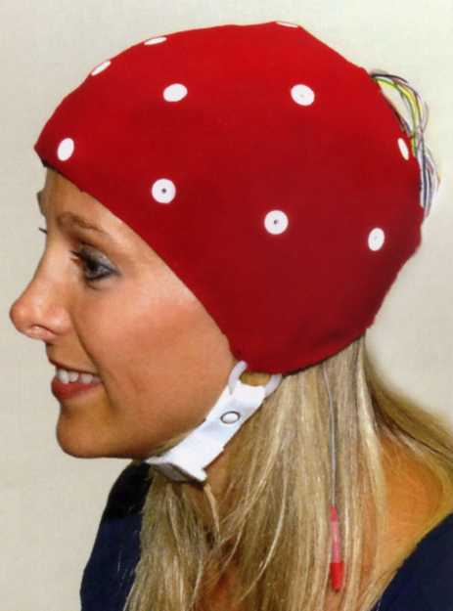
38

Slide 39
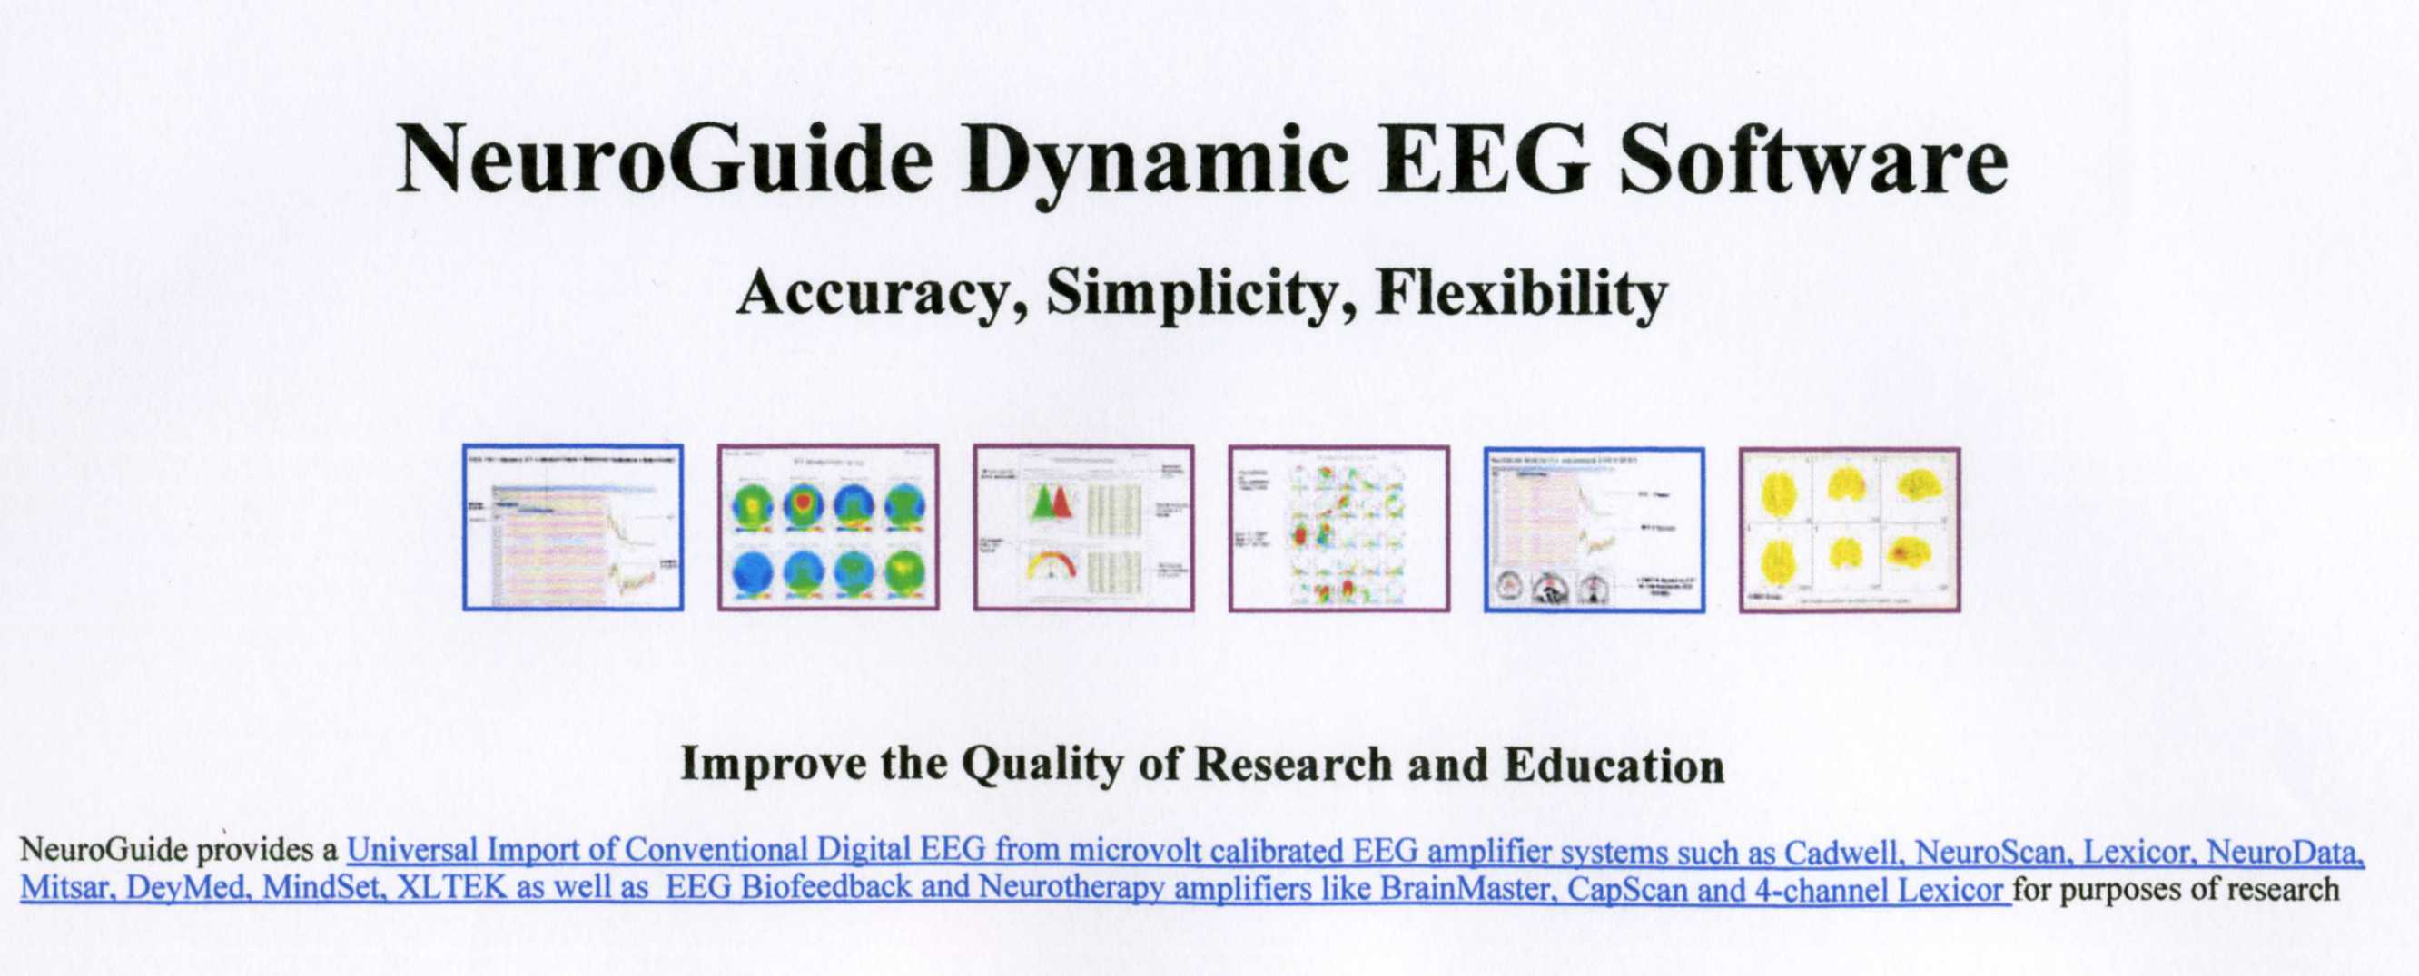
The “golden standard”, as a software
for QEEG, is NeuroGuide.

Slide 40
The ClinicalQ Procedure
Swingle proposed an QEEG assessment including a four site analysis, able to give relevant information about many psychiatric disorders and also to allow training the patients using Neurofeedback.

Slide 41
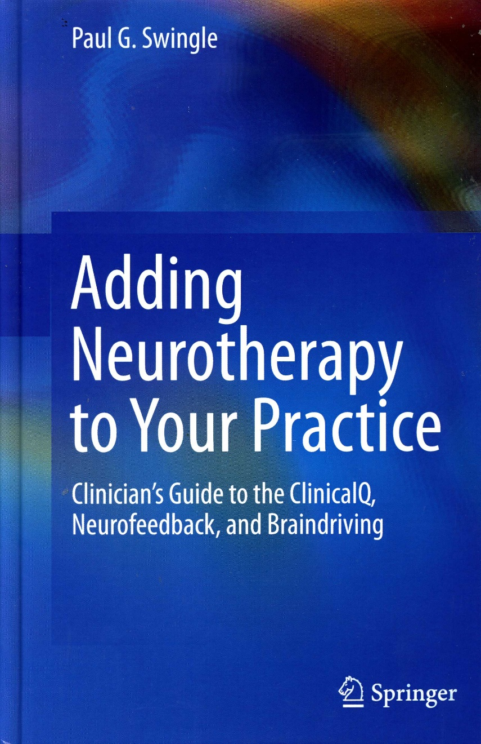

Slide 42
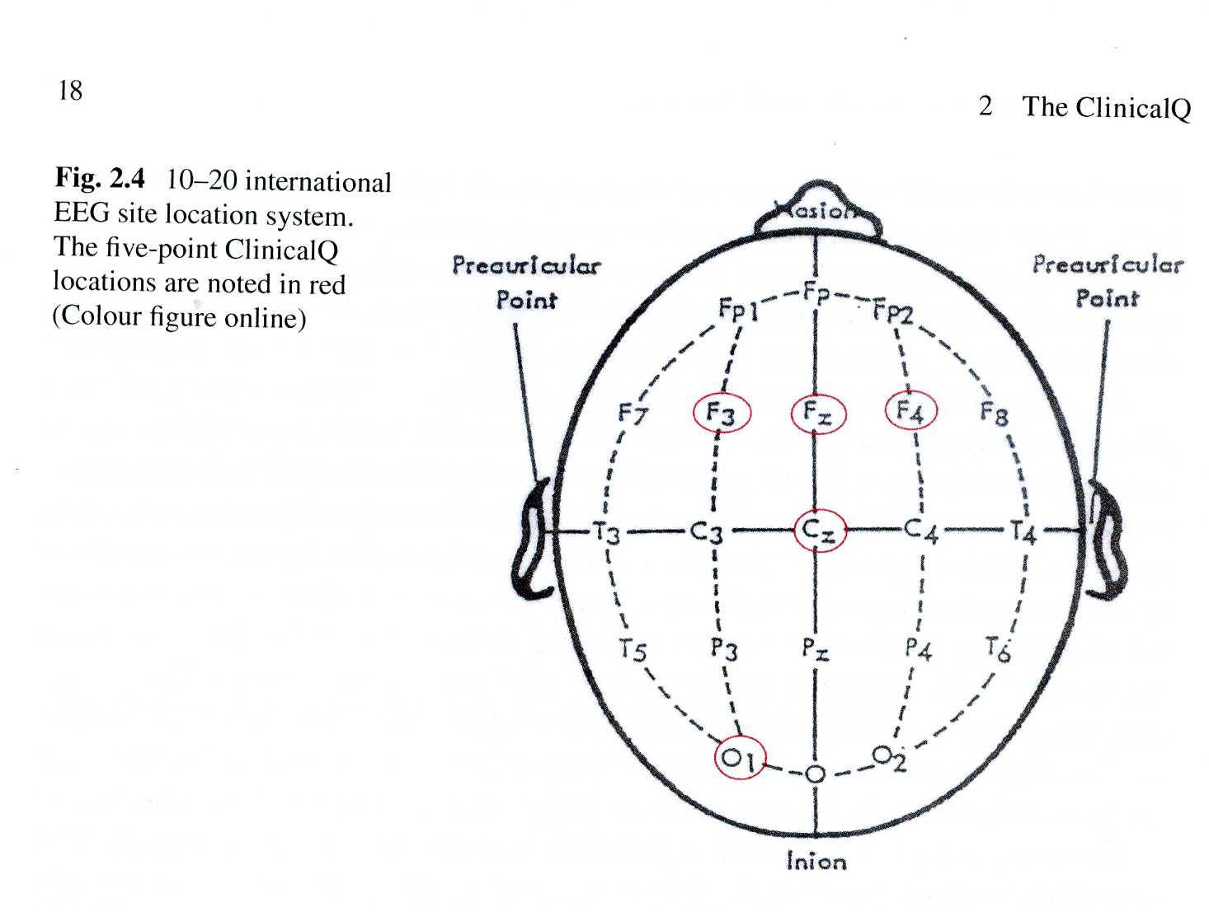

Slide 43
Frontal QEEG
I developed a new method for Quantitative Frontal EEG (QFEE) and for Neurofeedback on which I am actually working.
Both could be very useful if integrated into Cognitive Therapy.
  43
43

Slide 44
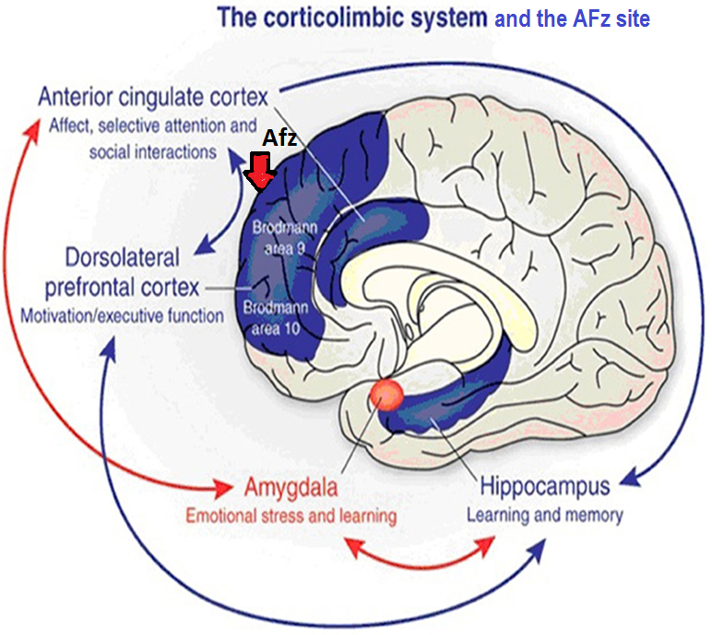

Slide 45
FRONTAL NEUROSCAN (F.N.) by Tullio Scrimali
Registration: one channel, unipolar
Montage: one active site on AFz (according to the 10-10 system)
Digital EEG analysis: Spectral Analysis by means of FFT

Slide 46
Electrodes (pre-gelled, adhesive and disposable):
Active: AFz
Black electrode (reference): Left mastoid
White electrode (ground reference): Right mastoid
Method: 5’ close eyes registration
Device: NeuroLAB Set
by Psychotech (powered by Vilistus)
Software: NeuroSCAN & Neurofeedback
by Psychotech (powered by Vilistus)
Normative and Clinical Database:
Demeter (Scrimali T., 2016)

Slide 47
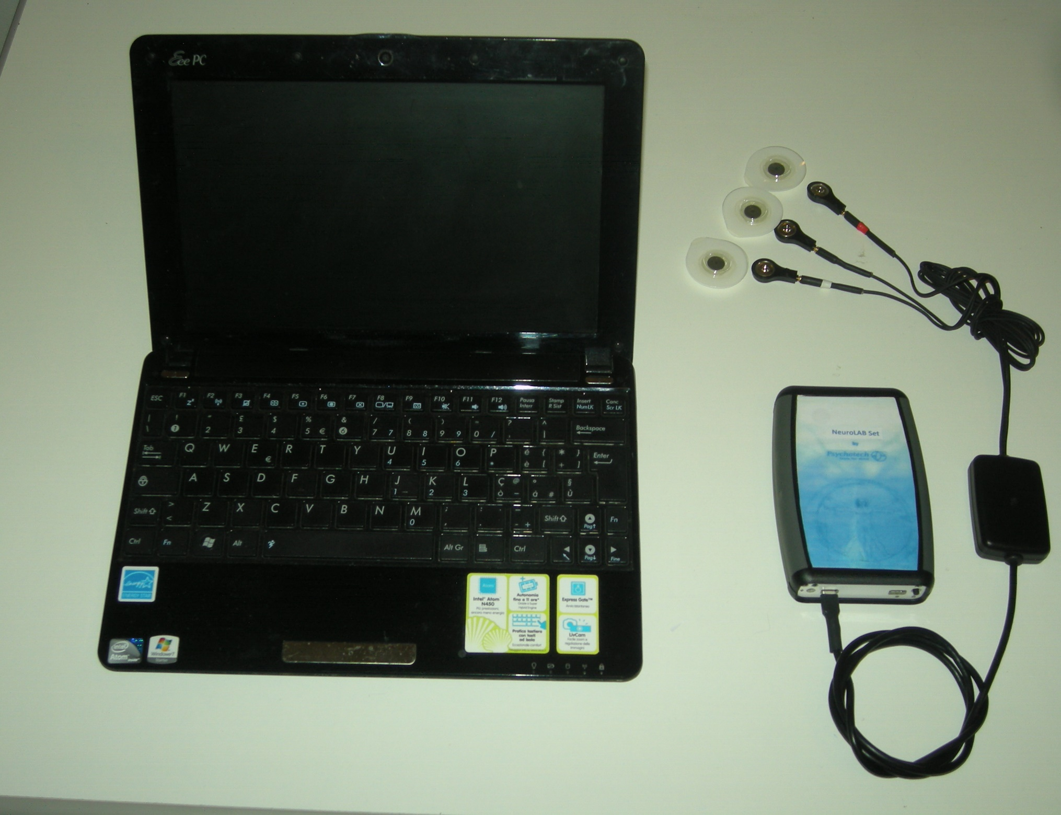

Slide 48
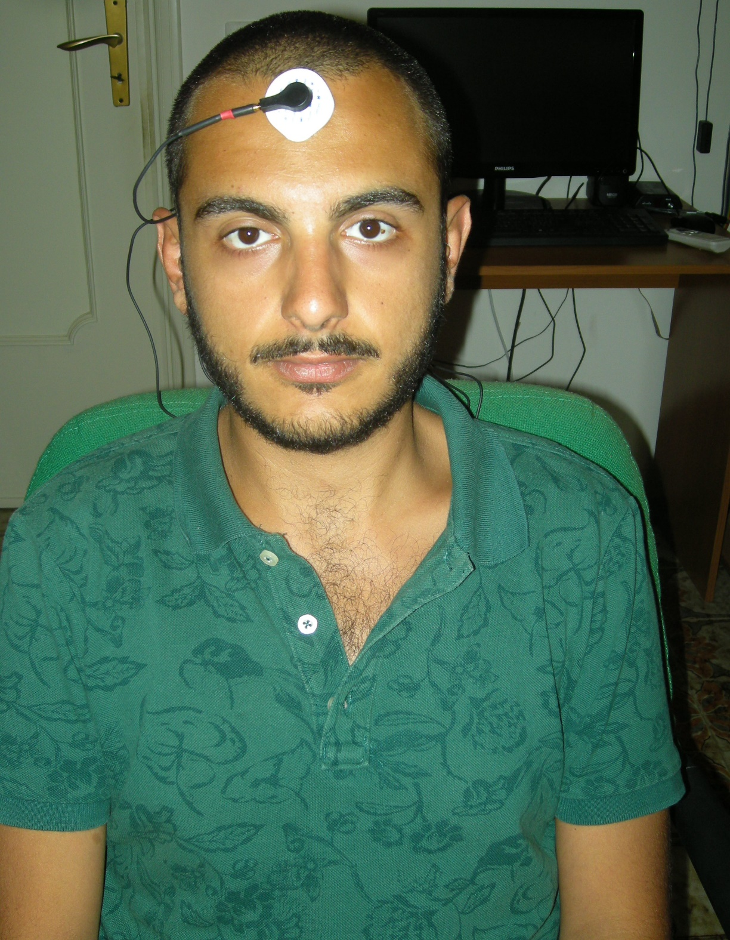

Slide 49
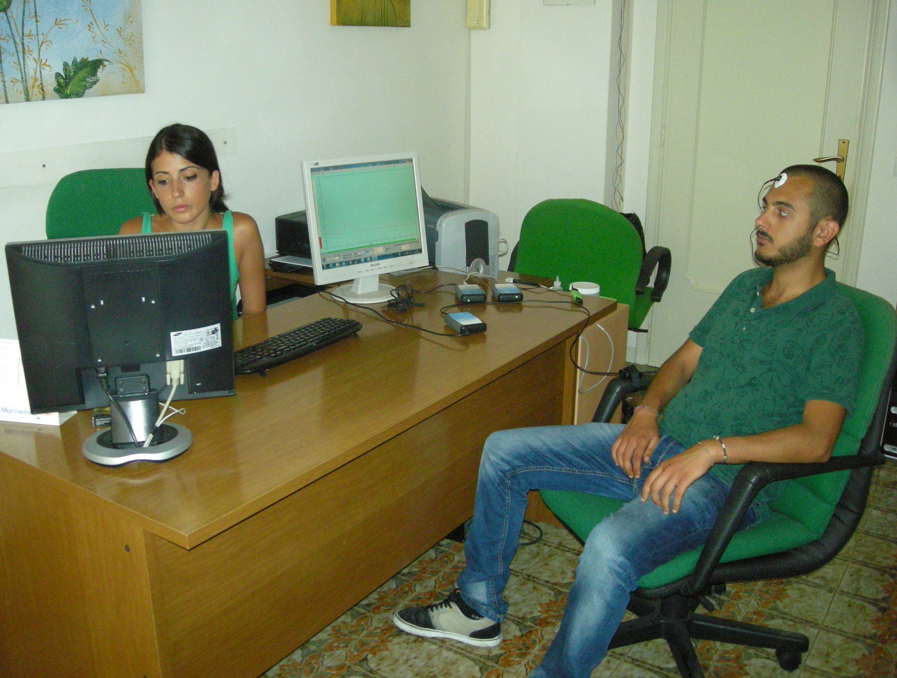

Slide 50
Frontal Neuroscan in Clinical Practice
High beta: anxiety disorders
High alpha (alpha I): depressive disorders
High theta: psychotic and dissociative disorders
High delta: Neurocognitive Disorders

Slide 51
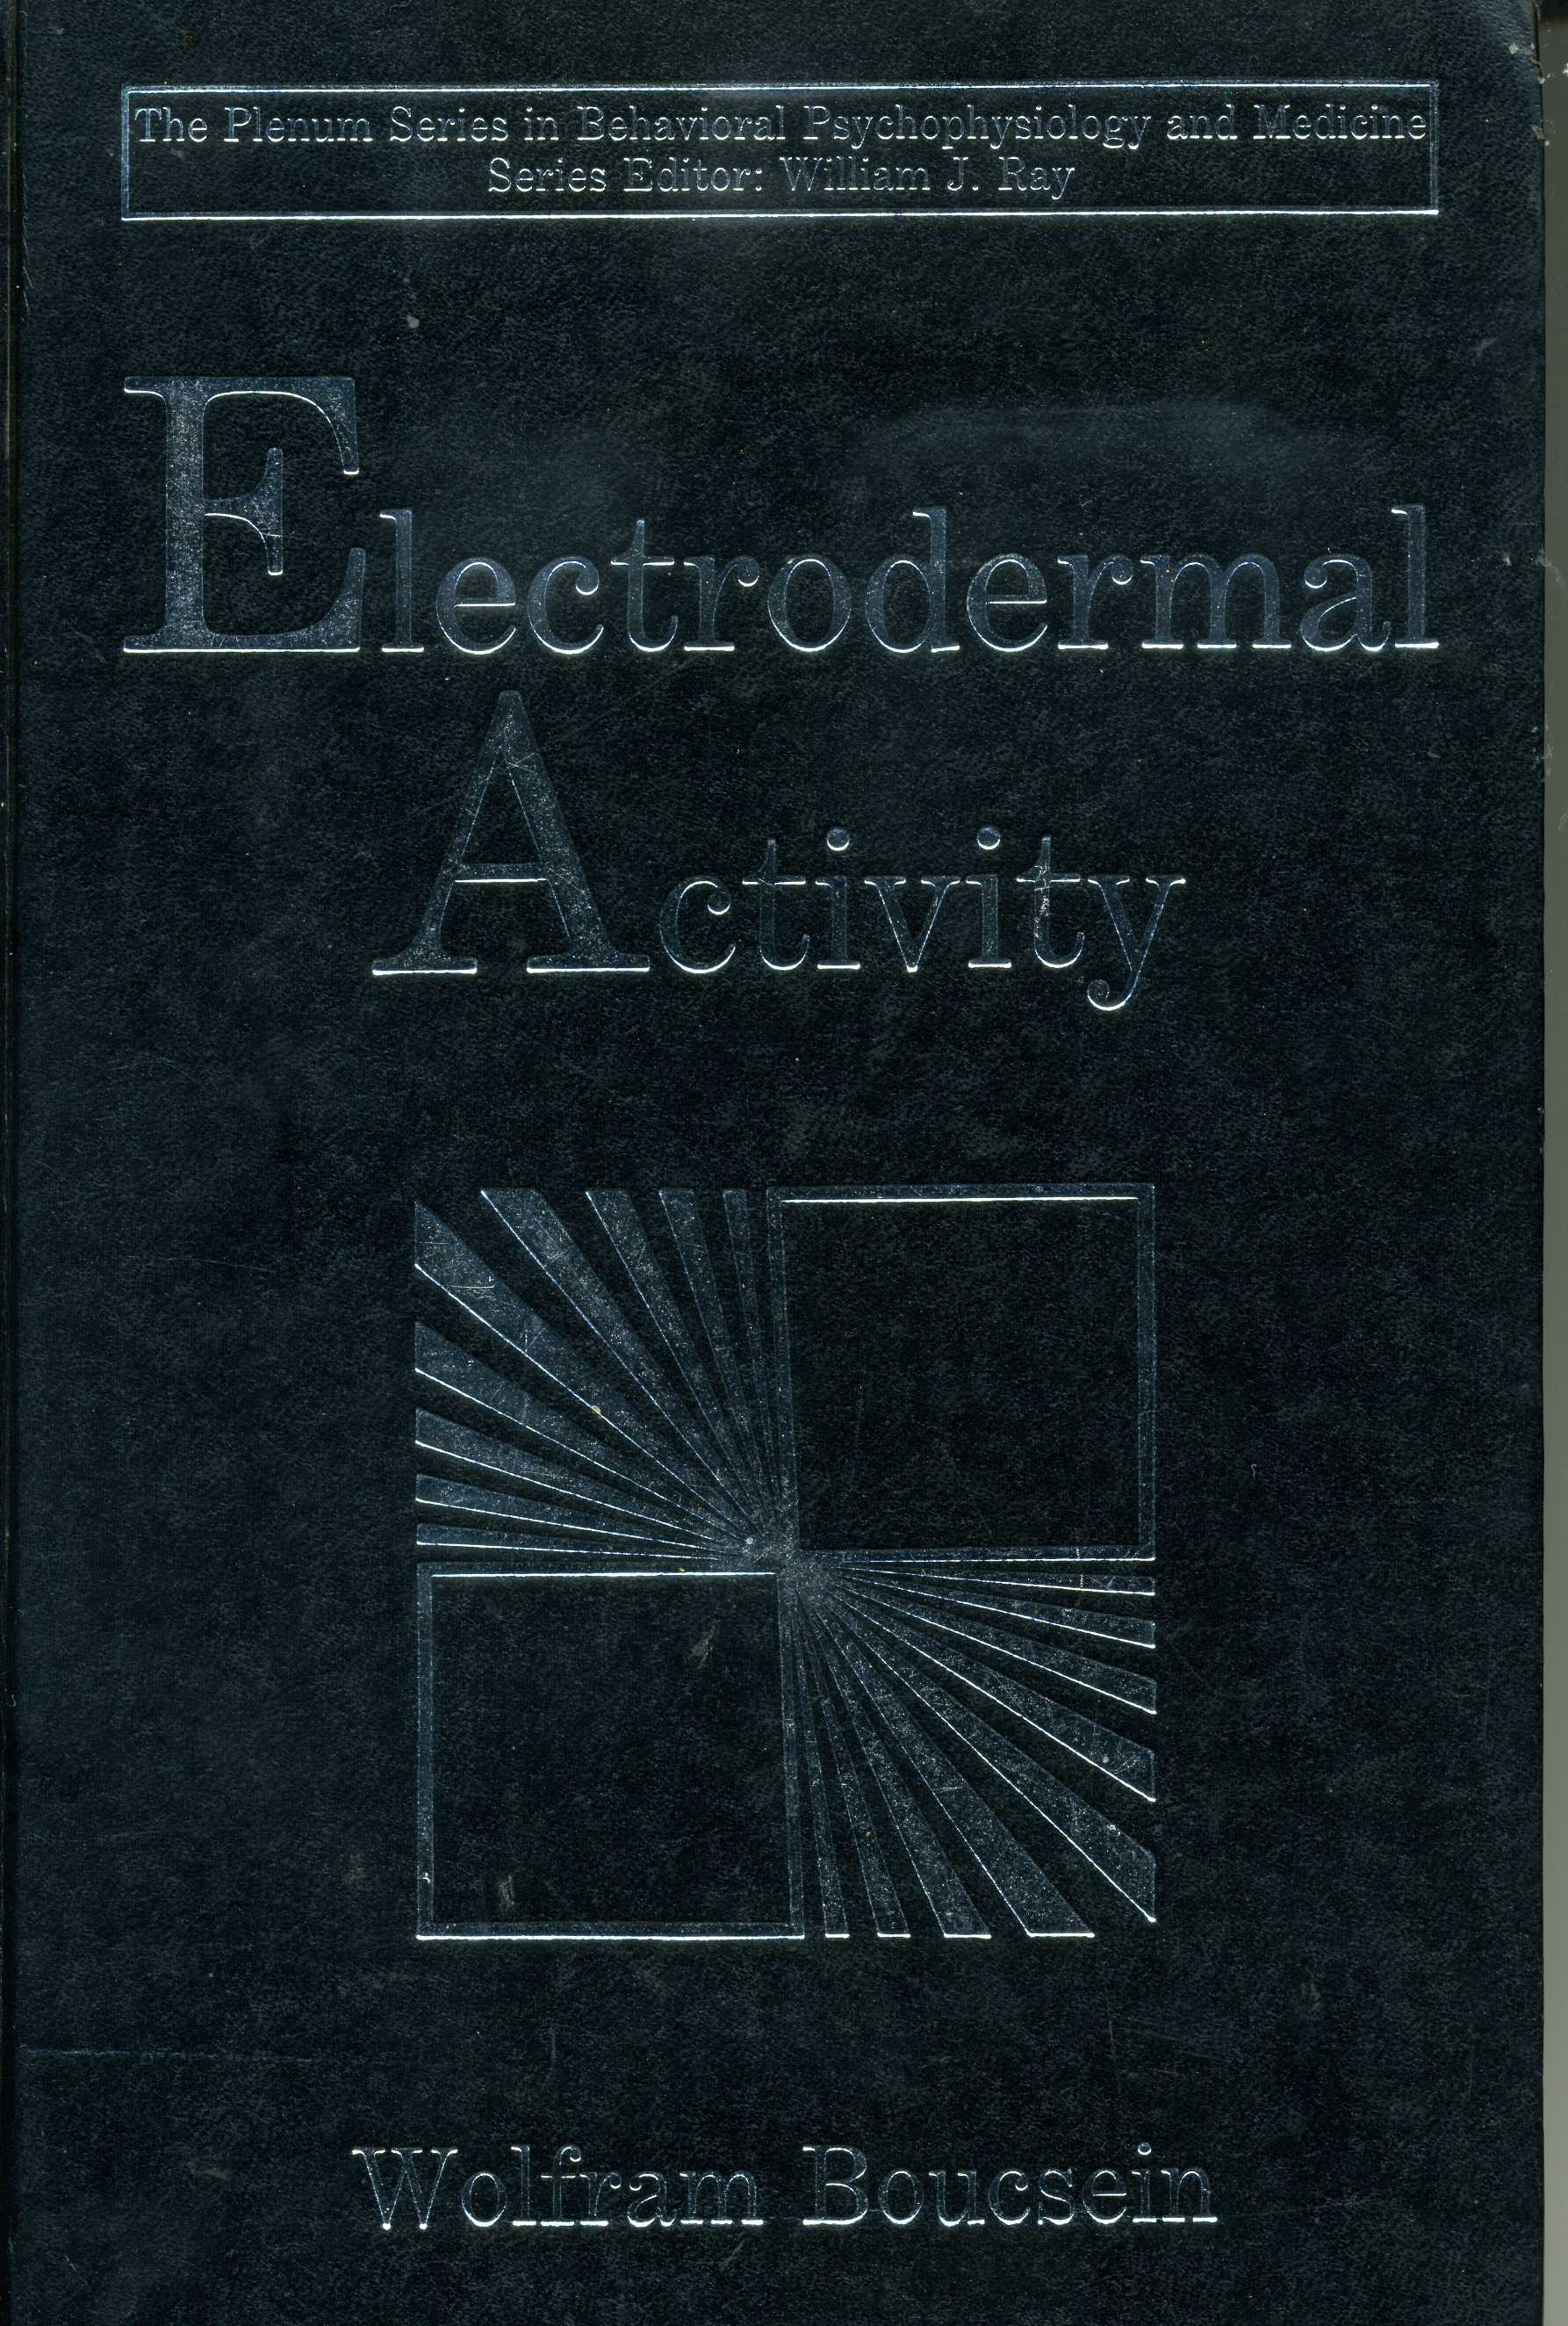

Slide 52
Electrodermal activity
For understanding this biological parameter it is important to spend some few word for explaining what conductivity is…

Slide 53
Electrical conductivity is the ability of any material to carry the flow of an electric current ( more specifically a flow of electrons). Electrical conductivity occurs because of the ease with which electrons can be removed from atoms.
Imagine that you attach the two ends of a battery to a bar of copper and a galvanometer. When this connection is made, the galvanometer shows that electric current is flowing through the copper bar.
The copper bar can be said to be a conductor of electric current. Replacing the iron bar in this system with other materials produces different galvanometer readings.

Slide 54
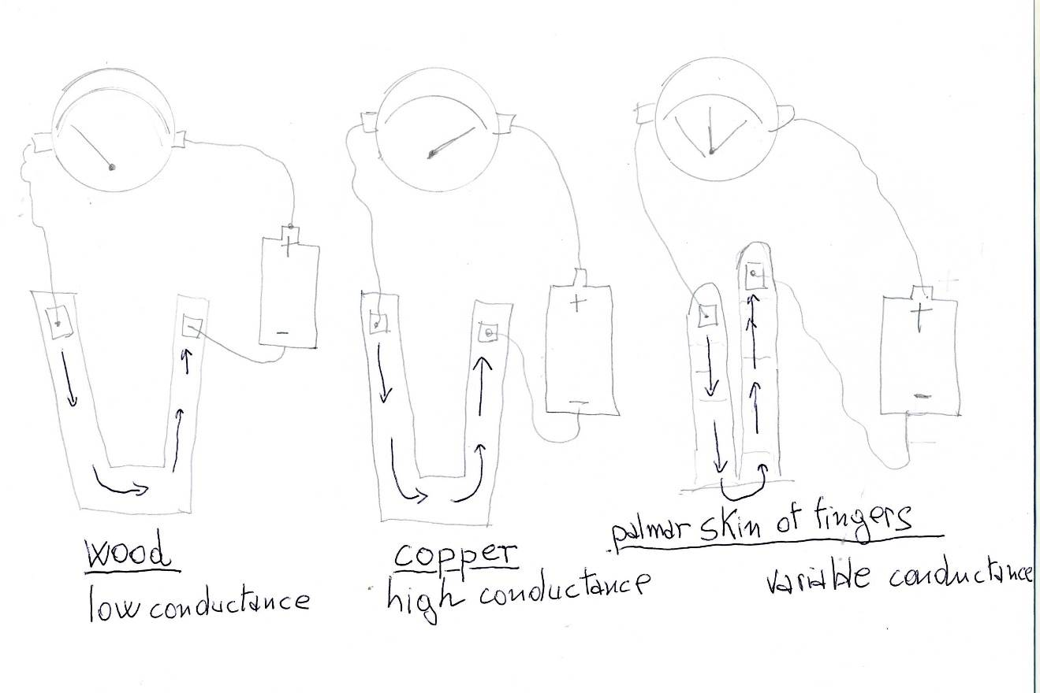

Slide 55
Solution conductivity
Electrons are not the only particles capable of carrying an electric current. Ions can also do it, too.
Suppose you dissolve a crystal of table salt (sodium chloride) in water.
In the solid state, these ions are not free to move around. Once they are dissolved in water, however, they become completely mobile. They are free to "swim" about in the water and to respond to an electric current from a battery.
That current supplies electrons that cause positive sodium ions to flow in one direction and negative chloride ions to flow in the opposite direction.
Read more: http://www.scienceclarified.com/Di-El/Electrical-Conductivity.html#ixzz483D6ad1F

Slide 56
Why the conductance of the skin, measured at palmar surface of our fingers, is variable?

Slide 57
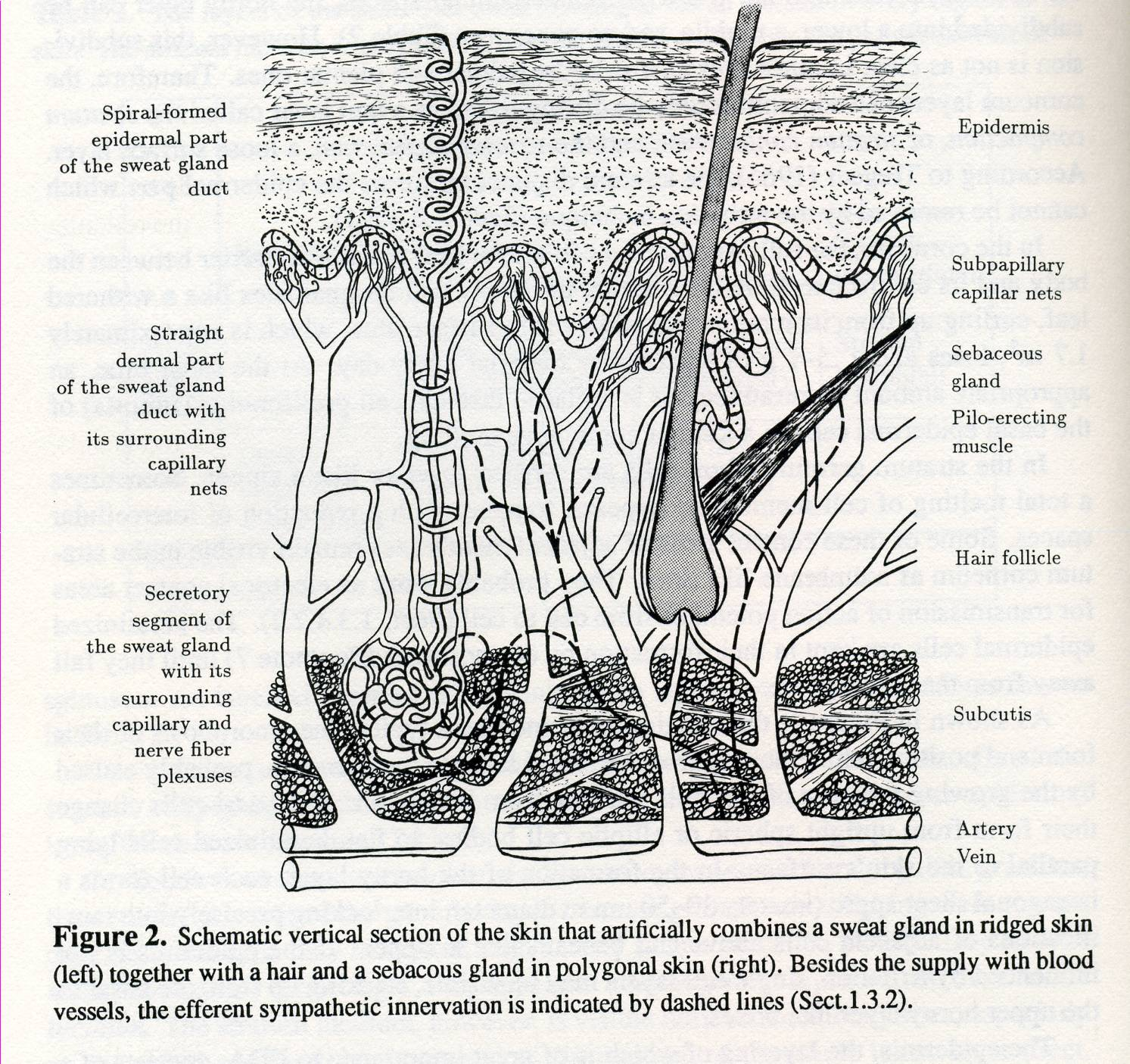
57

Slide 58
Because the quantity of ions that, in any moment, hydrates the surface of the skin is due to the activity of sweat glands.
This activity is regulated by brain and it varies according to the arousal.

Slide 59
Fingers’ Sweating and Arousal
Arousal increases the sympathetic activity which makes sweat glands working more actively.
This means that more ions are present in the palmar surface of fingers and this increase the electrodermal conductance.

Slide 60
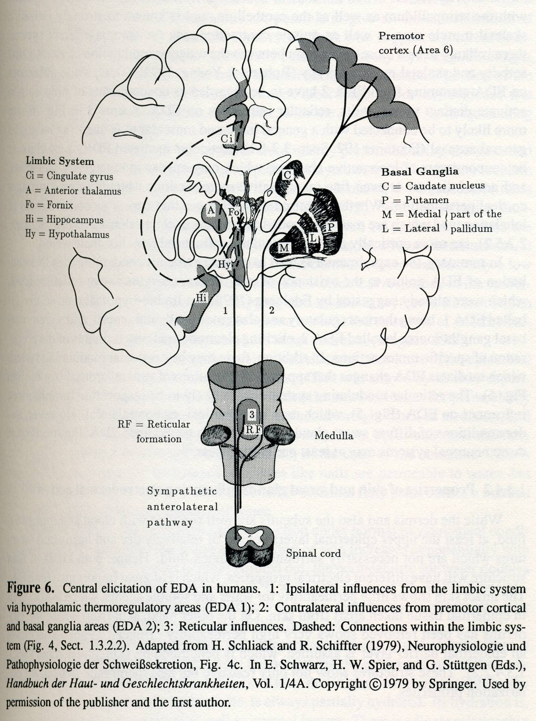
  60

Slide 61
EDA monitoring
It is easy and can be carried out with some simple and not expensive devices.
In a record of electrodermal activity we can describe the Skin Conductance Level which is the absolute value of the conductance and the phasic activity (some waves), both spontaneous (provoked by mental activity) and evoked (by different kinds of stimuli).

Slide 62
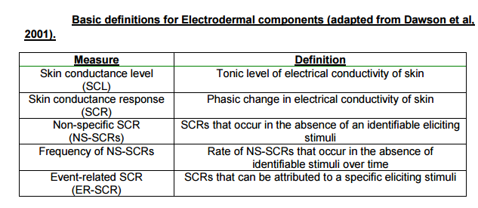

Slide 63
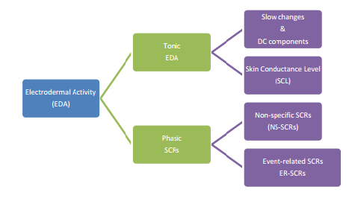

Slide 64
From EDA to QEDA
A quantitative analysis of EDA (QEDA) can be carried out thanks to the achievement of the following goals:
the use of a computer
the development of some specific software
creating and using a normative database

Slide 65
MindLAB Set and
Neurobiology of Mind
Activated states of mind such as high mood or anxiety are connected with sympathetic arousal.
Electrodermal activity, then is an optimal monitor of activation, anxiety and mood!
We could name MindLAB Set a…

Slide 66
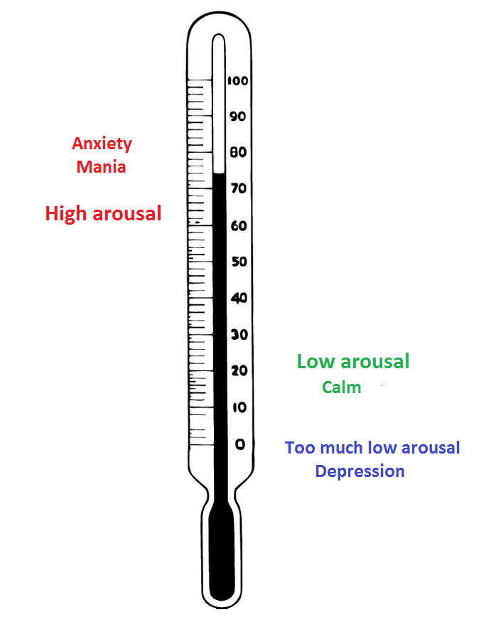

Slide 67
Neuroscience-based setting when applied in CBT

Slide 68
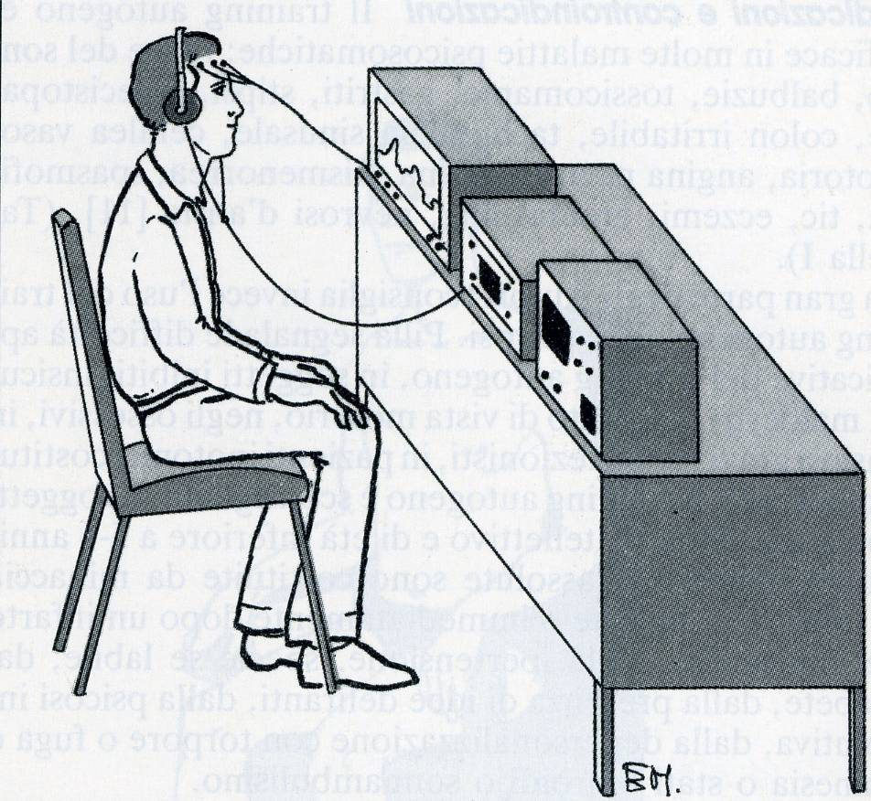
Biofeedback and Neurofeedback

Slide 69
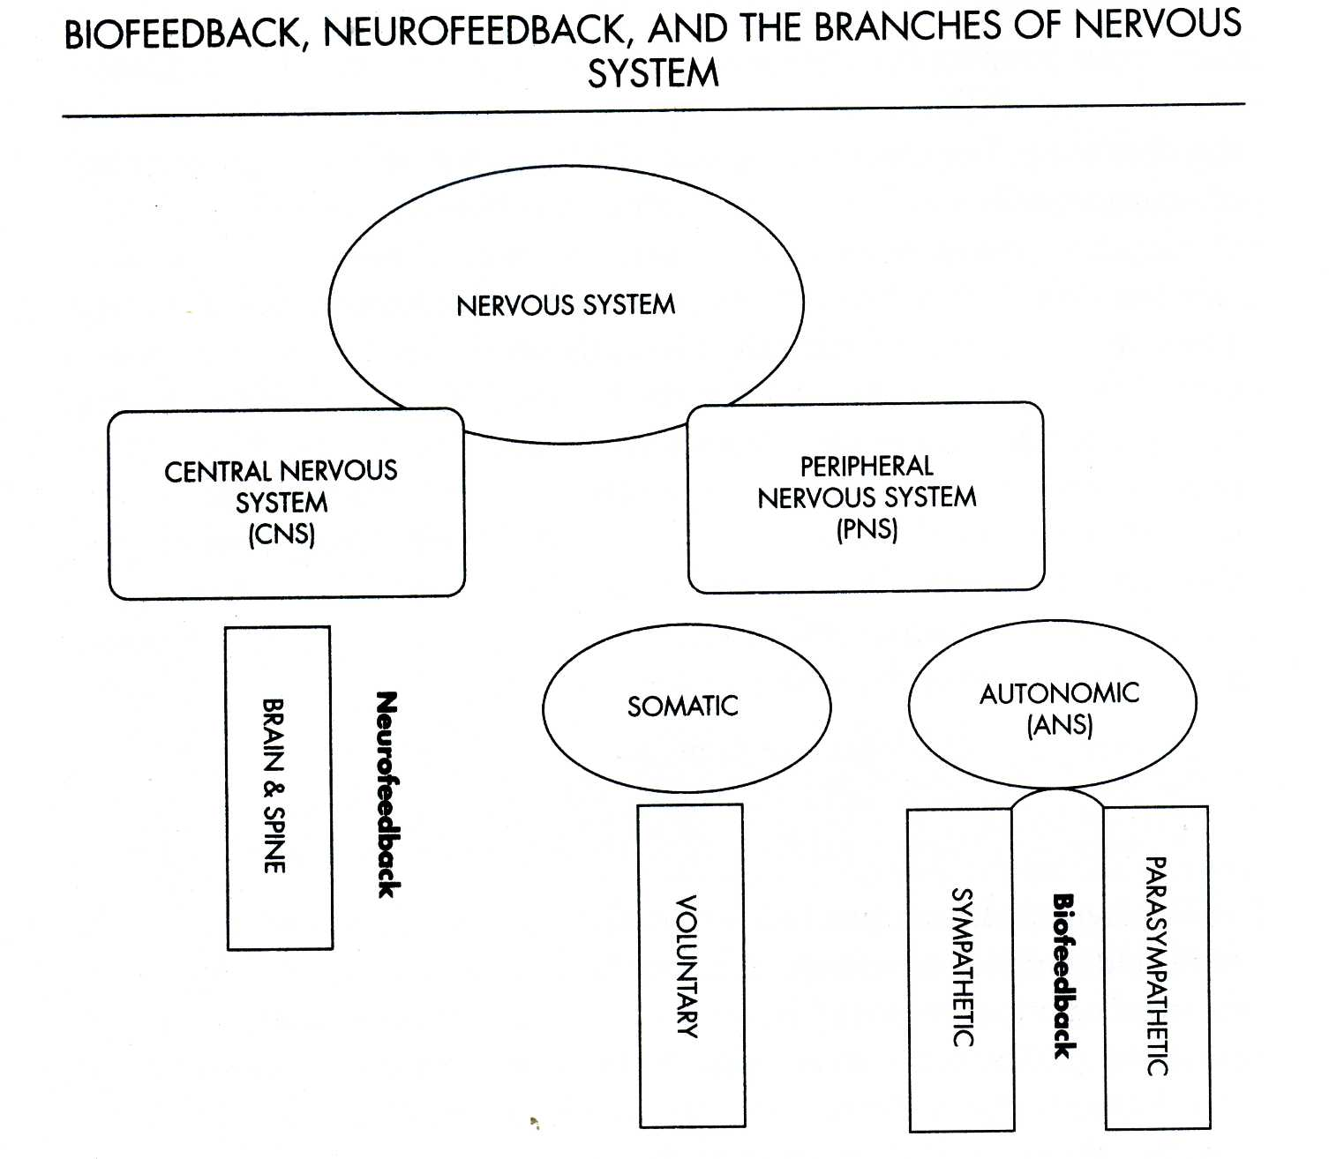

Slide 70
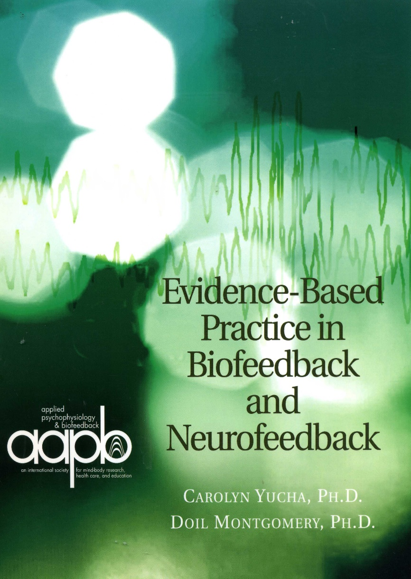
CLINICAL APPLICATIONS OF NEUROFEEDBACK & BIOFEEDBACK
Depression
Anxiety
Eating disorders
Bipolar disorder
Sleep disorders
Sexual dysfunctions
Substance-related and
addictive disorders
Personality disorders

Slide 71
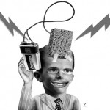
Future perspectives in Neurotherapy

Slide 72
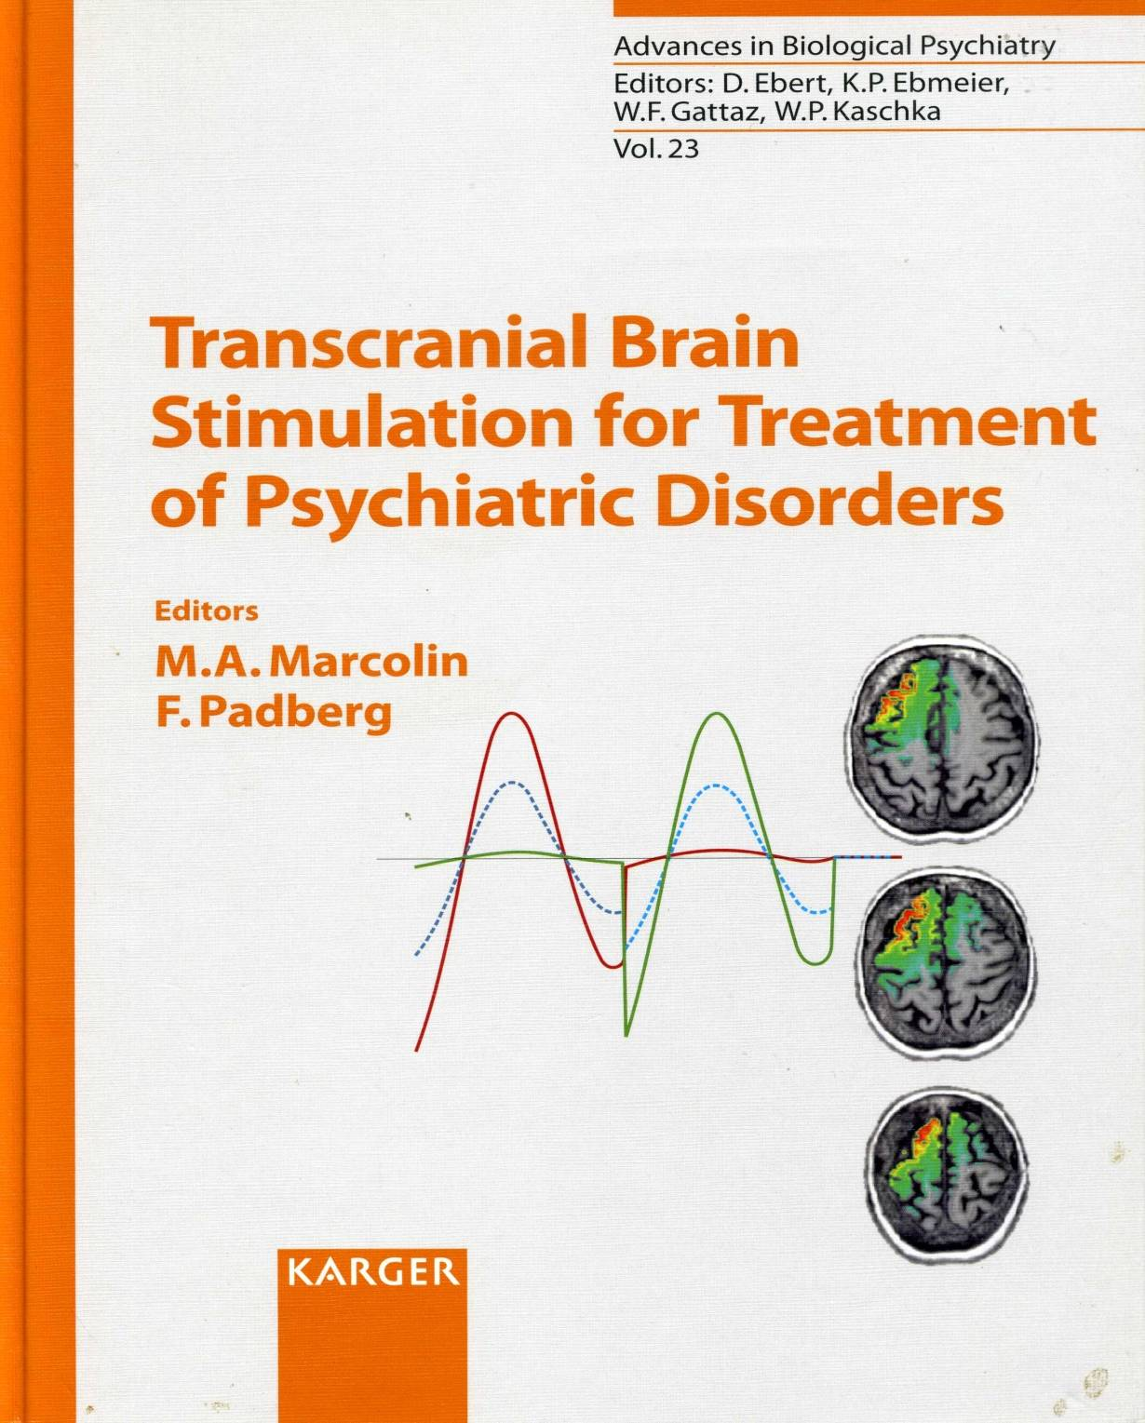

Slide 73
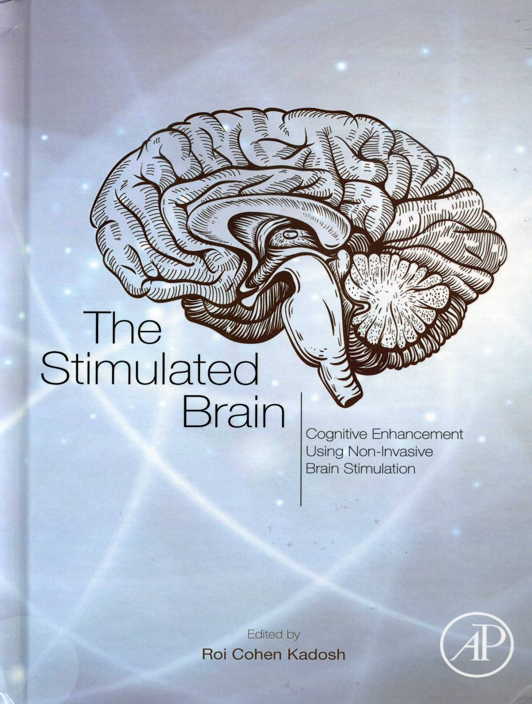

Slide 74

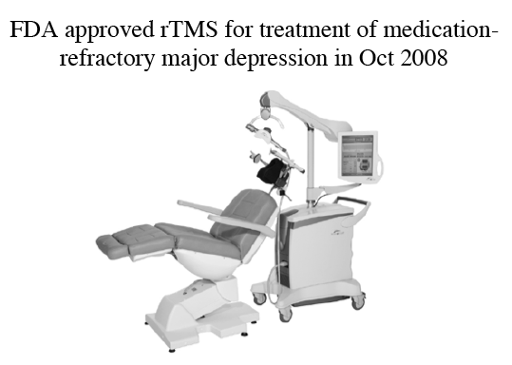



CLINICAL APPLICATIONS OF TMS

Slide 75
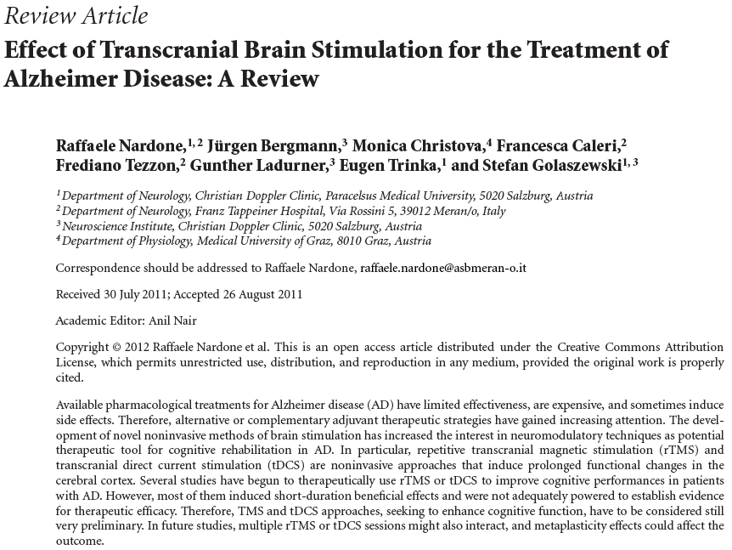

Slide 76
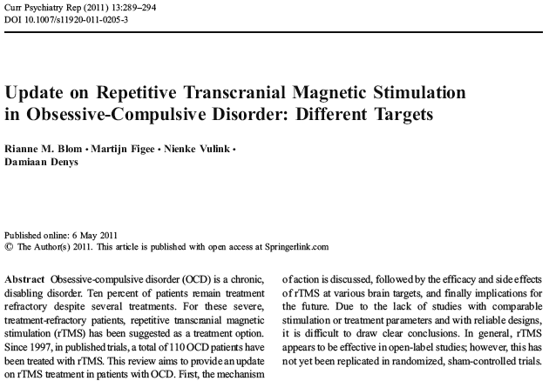

Slide 77
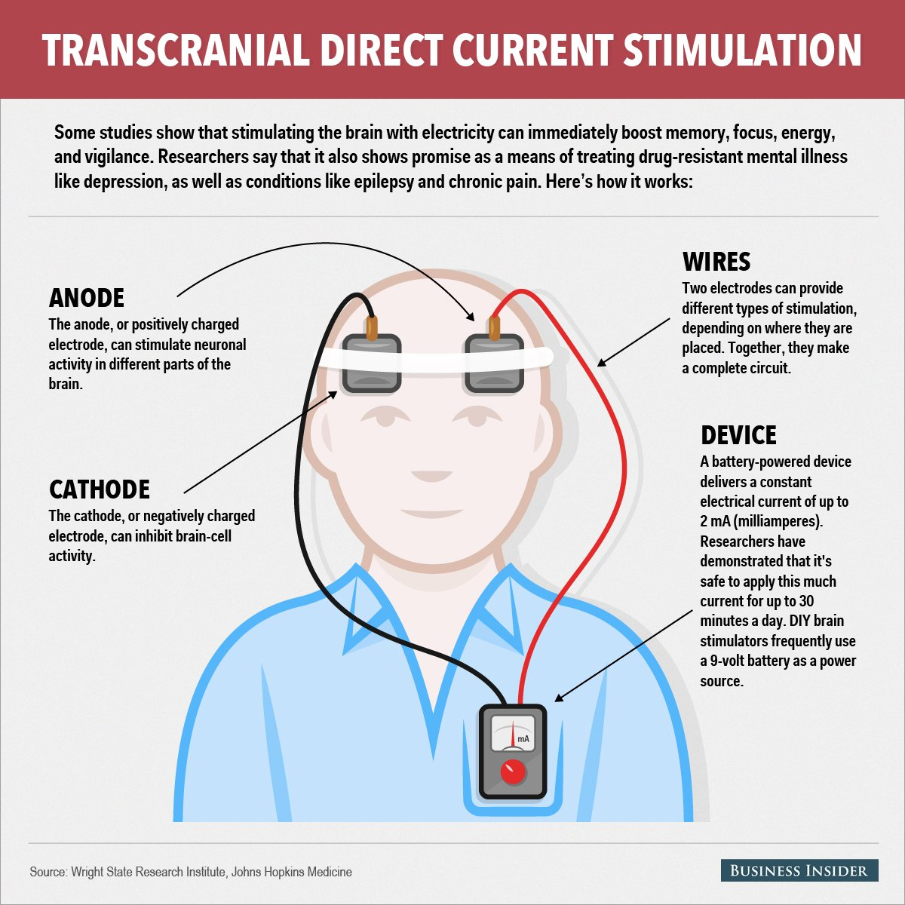

Slide 78
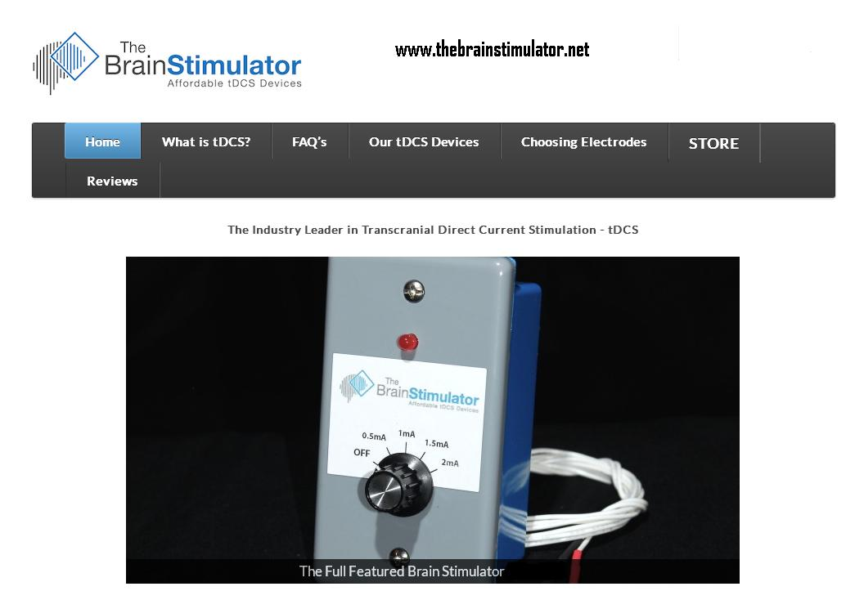

Slide 79
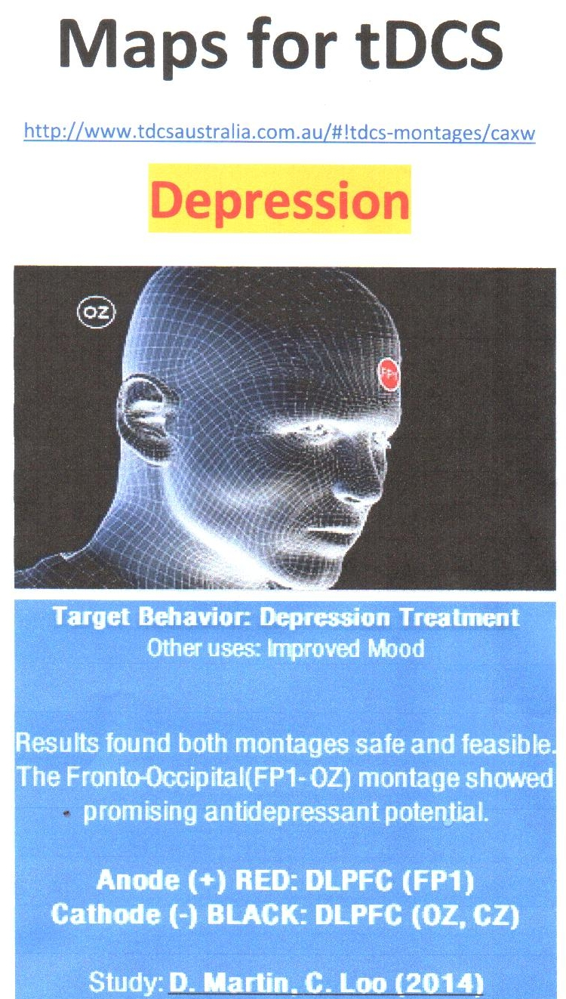

Slide 80
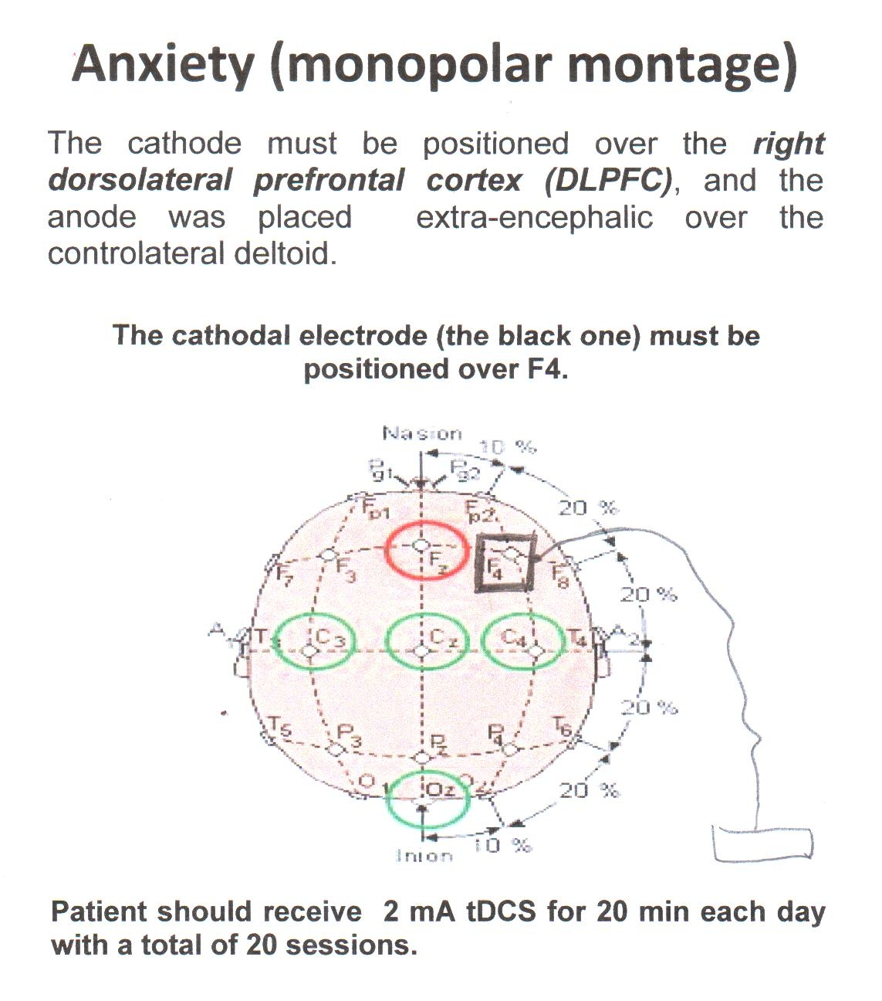

Slide 81
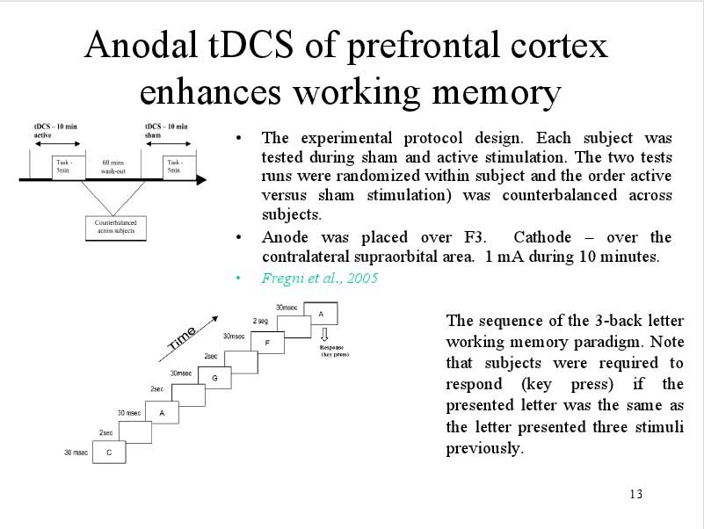

Slide 82

tDCS for Addictive disorders
the electrodes montage
A typical montage is prefrontal transcranial direct current stimulation (tDCS) (anode over the right prefrontal cortex and cathode over the left prefrontal cortex).

Slide 83
My personal point of view on tDCS
It is not a therapy but just a technique of Neurotherapy which must be integrated into Psychotherapy and Rehabilitation!

Slide 84
ALETEIA Clinical Center and Neuroscience-Based Cognitive Therapy
I set up two clinical and research Units in Enna and Catania named
Centro Clinico ALETEIA.
In this Centers we apply an integrated, complex, neuroscience and evidence based approach to the treatment of mental disorders.
When I was young, mental disorders were incurable, nowadays they are treatable, tomorrow the complete recovery will be possible!

Slide 85


Is Tullio Scrimali a dreamer ?
You may say I am a dreamer but I am not the only one! One day you will join us and the world will be one!

Slide 86
The end !
For any question or enquiry you can write an email to:
tscrima@tin.it

